Slide 1

Speculative Loop Pipelining for
High-Level Synthesis
Jean-Michel Gorius, Steven Derrien, Simon Rokicki
(With contributions from Tomofumi Yuki & Thibault Marty)
TARAN research Group, IRISA/INRIA
Notes:
I will present our work about automatically improving the efficiency of loop pipelining in FPGAs by speculative execution. This work has been done by members of the CAIRN team at the French lab IRISA/INRIA.

Slide 2
Disclaimer : my (biased) perspective
I am a computer engineer : I build computers
(I am mainly interested in embedded computers)
FPGA
Technology
Applications
CAD Tools & compilers
07/07/2022
Journée Calcul – GDR ISIS
2

Slide 3
Outline
High Level Synthesis in a nutshell
Loop pipelining in High Level Synthesis
The case for dynamic & speculative pipelining
Overview of SpecHLS
Performance evaluation & results
Conclusion & ongoing work

Slide 4
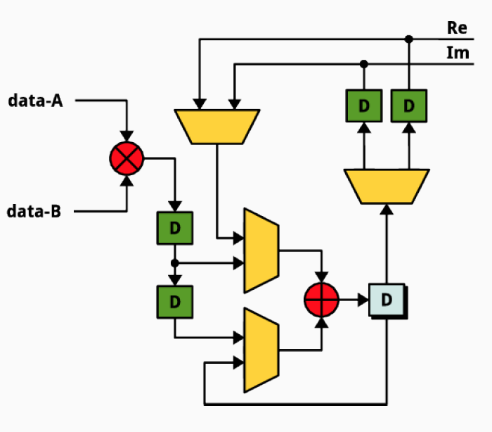
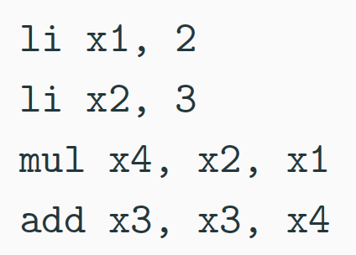
Hardware Design ≠ Programming
Hardware design is difficult and tedious
No instruction set abstraction, complex design toolchains
Notes:
- structure décrit implicitement le comportement
- pas d'abstraction de type ISA
- outils de CAO != compilateur

Slide 5
High Level Synthesis
From C to digital circuit/hardware accelerators
for(i=0;i<N;i++) {
x = x + y[i];
}
Datapath
Control
1
Register
(D flip-flop)
RAM
i
x
FSM
Notes:
High-Level Synthesis is an approach to improve productivity of hardware design. HLS tools take behavioral specifications in higher level languages (typically C) and generates corresponding hardware designs.
The HLS tools generate two components: the datapath, which is responsible for performing all the computations, and the control, which is responsible for feeding the right data to the datapath. In this example, the accumulation in the loop body becomes the datapath, and the control corresponds to the loop.
HLS tools greatly increases productivity, and even though the generated hardware may not be as efficient as hand crafted designs, the fact that you can explore a lot more design options in much shorter time often leads to better designs.

Slide 6
What can I use HLS for ?
Loop nests
High arithmetic intensity
Complex control flow
Low arithmetic intensity
C/C++
C/C++
HDL
HDL
Lin. Algebra
Convolutions
FFT, DCT, etc.
Graph analytics, sparse CNN, packet processing , etc.
DRAM controller
Bus arbiter, etc.

Slide 7
Single cycle loop scheduling in HLS
Schedule one full iteration per clock cycle
Low clock speed, low CPI*=1
X[i]= F(Z[i]);
S
F
F |  |  | F₂
S₁ |  |  | S₂
for(i=4;i<…;i++) {
X[i]= F(Z[i]);
Y[i]= S(Z[i]);
}
Y[i]= S(Z[i]);
T_{clk}
t
loop kernel
Tick n
Tick n+1
Execution trace
Datapath
*CPI = Clock Per Iteration
Notes:
An important optimization in HLS is loop pipelining. The loop body may be split into multiple stages to overlap the execution of multiple loop iterations, increasing the amount of parallelism. The overhead is very small, since it only requires adding registers between stages. This makes loop pipelining one of the most important optimizations in HLS.
However, loop pipelining is constrained by the dependences across loop iterations. The dependence distance, that is the number of loop iterations before a values produced by a statement is used, constraints loop pipelining.
In this example, the function F has a dependence distance of one, because it uses the value produced by the previous iteration. Since F takes one cycle, there is no problem to execute F every cycle. The function S is more tricky because it takes 3 cycles to produce an output. In this example, the pipelining is legal because the dependence distance is 3, giving enough time for the outputs to be produced.

Slide 8
Multi cycle loop scheduling in HLS
Schedule one iteration over multiple clock cycles
Results in high clock speed, high CPI
X[i]= F(X[i-1]);
S
F
F |  |  | F₂
S₁ |  |  | S₄
 | S₁ |  |  | S₄
 |  | S₁ |  |  | S₄
for(i=4;i<…;i++) {
X[i]= F(Z[i]);
Y[i]= S(Z[i]);
}
Stage 1
Y[i]= S(Y[i-3]);
Stage 2
loop kernel
Stage 3
t
Tick n
Tick n+1
Datapath
Execution trace
Notes:
An important optimization in HLS is loop pipelining. The loop body may be split into multiple stages to overlap the execution of multiple loop iterations, increasing the amount of parallelism. The overhead is very small, since it only requires adding registers between stages. This makes loop pipelining one of the most important optimizations in HLS.
However, loop pipelining is constrained by the dependences across loop iterations. The dependence distance, that is the number of loop iterations before a values produced by a statement is used, constraints loop pipelining.
In this example, the function F has a dependence distance of one, because it uses the value produced by the previous iteration. Since F takes one cycle, there is no problem to execute F every cycle. The function S is more tricky because it takes 3 cycles to produce an output. In this example, the pipelining is legal because the dependence distance is 3, giving enough time for the outputs to be produced.

Slide 9
Outline
High Level Synthesis in a nutshell
Loop pipelining in High Level Synthesis
The case for dynamic & speculative pipelining
Overview of SpecHLS
Performance evaluation & results
Conclusion & ongoing work

Slide 10
Loop Pipelining in HLS
Overlaps operations from distinct iterations
May result in high clock speed, low CPI
X[i]= F(Z[i]);
S
F
Stage 1
F | F₂ | F₃ | F₄ | F₅ | F₆
S₁ | S₂ | S₃ | S₄ | S₅ | S₆
 | S₁ | S₂ | S₃ | S₄ | S₅
 |  | S₁ | S₂ | S₃ | S₄
for(i=4;i<…;i++) {
X[i]= F(Z[i]);
Y[i]= S(Z[i]);
}
F | F₂
S₁ | S₂
Stage 2
loop kernel
Stage 3
Y[i]= S(Z[i]);
Execution trace
Datapath
Notes:
An important optimization in HLS is loop pipelining. The loop body may be split into multiple stages to overlap the execution of multiple loop iterations, increasing the amount of parallelism. The overhead is very small, since it only requires adding registers between stages. This makes loop pipelining one of the most important optimizations in HLS.
However, loop pipelining is constrained by the dependences across loop iterations. The dependence distance, that is the number of loop iterations before a values produced by a statement is used, constraints loop pipelining.
In this example, the function F has a dependence distance of one, because it uses the value produced by the previous iteration. Since F takes one cycle, there is no problem to execute F every cycle. The function S is more tricky because it takes 3 cycles to produce an output. In this example, the pipelining is legal because the dependence distance is 3, giving enough time for the outputs to be produced.

Slide 11
In a nutshell
Pipelining very effective at improving performance
X[i]= F(X[i-1]);
X[i]= F(X[i-1]);
X[i]= F(X[i-1]);
F |  |  | F₂
S₁ |  |  | S₄
 | S₁ |  |  | S₄
 |  | S₁ |  |  | S₄
F | F₂ | F₃ | F₄ | F₅ | F₆
S₁ | S₂ | S₃ | S₄ | S₅ | S₆
 | S₁ | S₂ | S₃ | S₄ | S₅
 |  | S₁ | S₂ | S₃ | S₄
F | F₂
S₁ | S₂
F | F₂
S₁ | S₂
Y[i]= S(Y[i-3]);
Y[i]= S(Y[i-3]);
Y[i]= S(Y[i-3]);
t
Tick n
Tick n+1
t
Tick n
Tick n+1
Low clock speed,
Low CPI
high clock speed,
high CPI
high clock speed,
Low CPI
Notes:
An important optimization in HLS is loop pipelining. The loop body may be split into multiple stages to overlap the execution of multiple loop iterations, increasing the amount of parallelism. The overhead is very small, since it only requires adding registers between stages. This makes loop pipelining one of the most important optimizations in HLS.
However, loop pipelining is constrained by the dependences across loop iterations. The dependence distance, that is the number of loop iterations before a values produced by a statement is used, constraints loop pipelining.
In this example, the function F has a dependence distance of one, because it uses the value produced by the previous iteration. Since F takes one cycle, there is no problem to execute F every cycle. The function S is more tricky because it takes 3 cycles to produce an output. In this example, the pipelining is legal because the dependence distance is 3, giving enough time for the outputs to be produced.

Slide 12

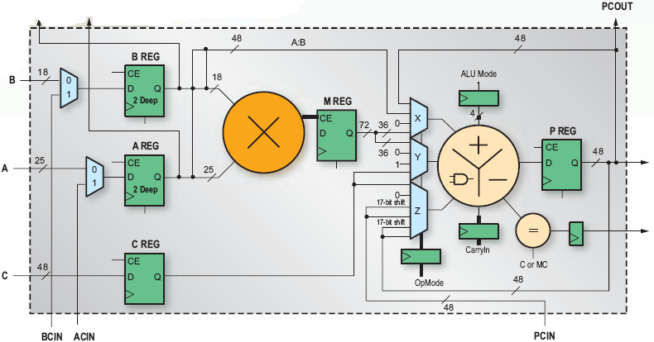
Pipelining & FPGAs
Pipelining is often possible for little overhead
FPGA have a lot of registers enabling very deep pipelines
Loop Pipelining is one of the most important optimization in HLS
Notes:
An important optimization in HLS is loop pipelining. The loop body may be split into multiple stages to overlap the execution of multiple loop iterations, increasing the amount of parallelism. The overhead is very small, since it only requires adding registers between stages. This makes loop pipelining one of the most important optimizations in HLS.
However, loop pipelining is constrained by the dependences across loop iterations. The dependence distance, that is the number of loop iterations before a values produced by a statement is used, constraints loop pipelining.
In this example, the function F has a dependence distance of one, because it uses the value produced by the previous iteration. Since F takes one cycle, there is no problem to execute F every cycle. The function S is more tricky because it takes 3 cycles to produce an output. In this example, the pipelining is legal because the dependence distance is 3, giving enough time for the outputs to be produced.

Slide 13
Pipelining and reuse distance
Overlapping distinct iterations is not always possible
Constrained by loop carried dependencies
X[i]= F(X[i-1]);
S
F
F |  |  | F₂
S₁ |  |  | S₂
 | S₁ |  |  | S₂
 |  | S₁ |  |  | S₂
Stage 1
for(i=4;i<…;i++) {
X[i]= F(X[i-1]);
Y[i]= S(Y[i-1]);
}
Stage 2
loop kernel
Stage 3
Y[i]= S(Y[i-1]);
Datapath
Execution trace
Notes:
An important optimization in HLS is loop pipelining. The loop body may be split into multiple stages to overlap the execution of multiple loop iterations, increasing the amount of parallelism. The overhead is very small, since it only requires adding registers between stages. This makes loop pipelining one of the most important optimizations in HLS.
However, loop pipelining is constrained by the dependences across loop iterations. The dependence distance, that is the number of loop iterations before a values produced by a statement is used, constraints loop pipelining.
In this example, the function F has a dependence distance of one, because it uses the value produced by the previous iteration. Since F takes one cycle, there is no problem to execute F every cycle. The function S is more tricky because it takes 3 cycles to produce an output. In this example, the pipelining is legal because the dependence distance is 3, giving enough time for the outputs to be produced.

Slide 14

Pipelining and reuse distance
What if the reuse distance is >1 ?
X[i]= F(X[i-1]);
S
F
F | F₂ | F₃ | F₄ | F₅ | F₆
S₁ | S₂ | S₃ | S₄ | S₅ | S₆
 | S₁ | S₂ | S₃ | S₄ | S₅
 |  | S₁ | S₂ | S₃ | S₄
for(i=4;i<…;i++) {
X[i]= F(X[i-1]);
Y[i]= S(Y[i-3]);
}
Stage 1
F | F₂
S₁ | S₂
Stage 2
loop kernel
Stage 3
Y[i]= S(Y[i-3]);
Execution trace
Datapath
Reuse distance $⟹$ pipeline depth $⟹$ clock speed T_{clk}
Notes:
An important optimization in HLS is loop pipelining. The loop body may be split into multiple stages to overlap the execution of multiple loop iterations, increasing the amount of parallelism. The overhead is very small, since it only requires adding registers between stages. This makes loop pipelining one of the most important optimizations in HLS.
However, loop pipelining is constrained by the dependences across loop iterations. The dependence distance, that is the number of loop iterations before a values produced by a statement is used, constraints loop pipelining.
In this example, the function F has a dependence distance of one, because it uses the value produced by the previous iteration. Since F takes one cycle, there is no problem to execute F every cycle. The function S is more tricky because it takes 3 cycles to produce an output. In this example, the pipelining is legal because the dependence distance is 3, giving enough time for the outputs to be produced.

Slide 15
Pipelining and reuse distance
HLS tool fail at precisely computing reuse distance
Use pessimistic (safe) estimates which hurt pipelining
X[i]= F(X[i-1]);
S
F
for(i=0;i<…;i++) {
for(j=i+3;j<…;j++) {
X[j]= F(X[j-1]);
Y[ j ]= S(Y[ i ]);
}
}
Stage 1
F |  |  | F₂
S₁ |  |  | S₄
 | S₁ |  |  | S₄
 |  | S₁ |  |  | S₄
j
i
Stage 2
Stage 3
loop kernel
Y[i]= S(Y[i-1]);
Datapath
Execution trace
Notes:
An important optimization in HLS is loop pipelining. The loop body may be split into multiple stages to overlap the execution of multiple loop iterations, increasing the amount of parallelism. The overhead is very small, since it only requires adding registers between stages. This makes loop pipelining one of the most important optimizations in HLS.
However, loop pipelining is constrained by the dependences across loop iterations. The dependence distance, that is the number of loop iterations before a values produced by a statement is used, constraints loop pipelining.
In this example, the function F has a dependence distance of one, because it uses the value produced by the previous iteration. Since F takes one cycle, there is no problem to execute F every cycle. The function S is more tricky because it takes 3 cycles to produce an output. In this example, the pipelining is legal because the dependence distance is 3, giving enough time for the outputs to be produced.

Slide 16
Pipelining and reuse distance
Program annotations can lift compiler limitations
This is no magic bullet though ….
X[i]= F(X[i-1]);
#pragma HLS dep Y dist=3
S
F
F | F₂ | F₃ | F₄ | F₅ | F₆
S₁ | S₂ | S₃ | S₄ | S₅ | S₆
 | S₁ | S₂ | S₃ | S₄ | S₅
 |  | S₁ | S₂ | S₃ | S₄
Stage 1
F |  |  | F₂
S₁ |  |  | S₄
 | S₁ |  |  | S₄
 |  | S₁ |  |  | S₄
for(i=0;i<…;i++) {
for(j=i+3;j<…;j++) {
X[j]= F(X[j-1]);
Y[ j ]= S(Y[ i ]);
}
}
Stage 2
Stage 3
Y[i]= S(Y[i-3]);
loop kernel
Datapath
Execution trace
Notes:
An important optimization in HLS is loop pipelining. The loop body may be split into multiple stages to overlap the execution of multiple loop iterations, increasing the amount of parallelism. The overhead is very small, since it only requires adding registers between stages. This makes loop pipelining one of the most important optimizations in HLS.
However, loop pipelining is constrained by the dependences across loop iterations. The dependence distance, that is the number of loop iterations before a values produced by a statement is used, constraints loop pipelining.
In this example, the function F has a dependence distance of one, because it uses the value produced by the previous iteration. Since F takes one cycle, there is no problem to execute F every cycle. The function S is more tricky because it takes 3 cycles to produce an output. In this example, the pipelining is legal because the dependence distance is 3, giving enough time for the outputs to be produced.

Slide 17
Outline
High Level Synthesis in a nutshell
Loop pipelining in High Level Synthesis
The case for dynamic & speculative pipelining
Overview of SpecHLS
Performance evaluation & results
Conclusion & ongoing work

Slide 18
Limits of static loop pipelining
Pipelined schedule based on worst-case scenario
  Poor support for runtime/data-dependent control-flow
do {
if(C(x)) {
// slow
x = S(x);
} else {
// fast
x = F(x);
}
} while (…)
80%
Stage 1
S
F
C
Stage 2
Stage 3
Notes:
In order to ensure correctness, the HLS tools must analyze the program to determine the dependence distance. However, there are cases where the distance cannot be determined at compile-time. One such example is is provided on the left. In this kernel, either the output of S or F, depending on the condition C, is used in the next iteration.
With static scheduling, the HLS tools must assume the worst case and only schedule the next iteration after both S and F have finished producing an output. This leads to inefficient use of the datapath. All the blank slots in the execution trace show when the pipelines stages are not utilized. In this example, there is effectively no pipelined parallelism.
(I suggest we drop path scheduling from this slide/talk)
In our work, we speculate that the fast path is always taken to efficiently use the pipeline stages. We add hazard detection and only wait for the slow path when necessary. This significantly improves the pipeline efficiency, making the execution trace much more dense.

Slide 19
Speculative loop pipelining ?
Pipelining can benefit from speculative execution !
  Speculatively overlap the execution of distinct iterations
  Rollback to a valid state when a mispeculation occured
do {
if(C(x)) {
// slow
x = S(x);
} else {
// fast
x = F(x);
}
} while (…)
80%
Stage 1
S
F
C
Stage 2
Stage 3
Notes:
In order to ensure correctness, the HLS tools must analyze the program to determine the dependence distance. However, there are cases where the distance cannot be determined at compile-time. One such example is is provided on the left. In this kernel, either the output of S or F, depending on the condition C, is used in the next iteration.
With static scheduling, the HLS tools must assume the worst case and only schedule the next iteration after both S and F have finished producing an output. This leads to inefficient use of the datapath. All the blank slots in the execution trace show when the pipelines stages are not utilized. In this example, there is effectively no pipelined parallelism.
(I suggest we drop path scheduling from this slide/talk)
In our work, we speculate that the fast path is always taken to efficiently use the pipeline stages. We add hazard detection and only wait for the slow path when necessary. This significantly improves the pipeline efficiency, making the execution trace much more dense.

Slide 20
Outline
High Level Synthesis in a nutshell
Loop pipelining in High Level Synthesis
The case for dynamic & speculative pipelining
Overview of SpecHLS
Performance evaluation & results
Conclusion & ongoing work

Slide 21
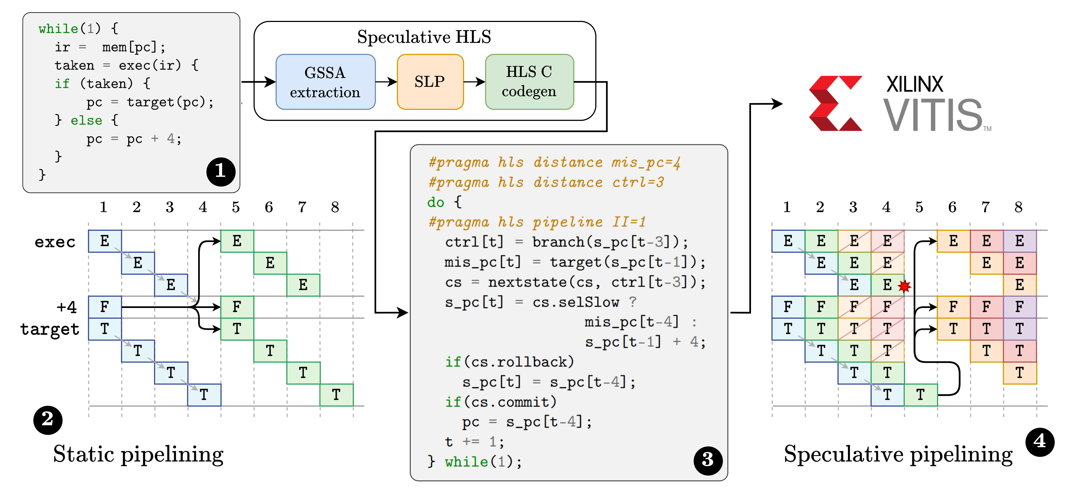
SpecHLS in a nutshell
07/07/2022
Journée Calcul – GDR ISIS
21

Slide 22
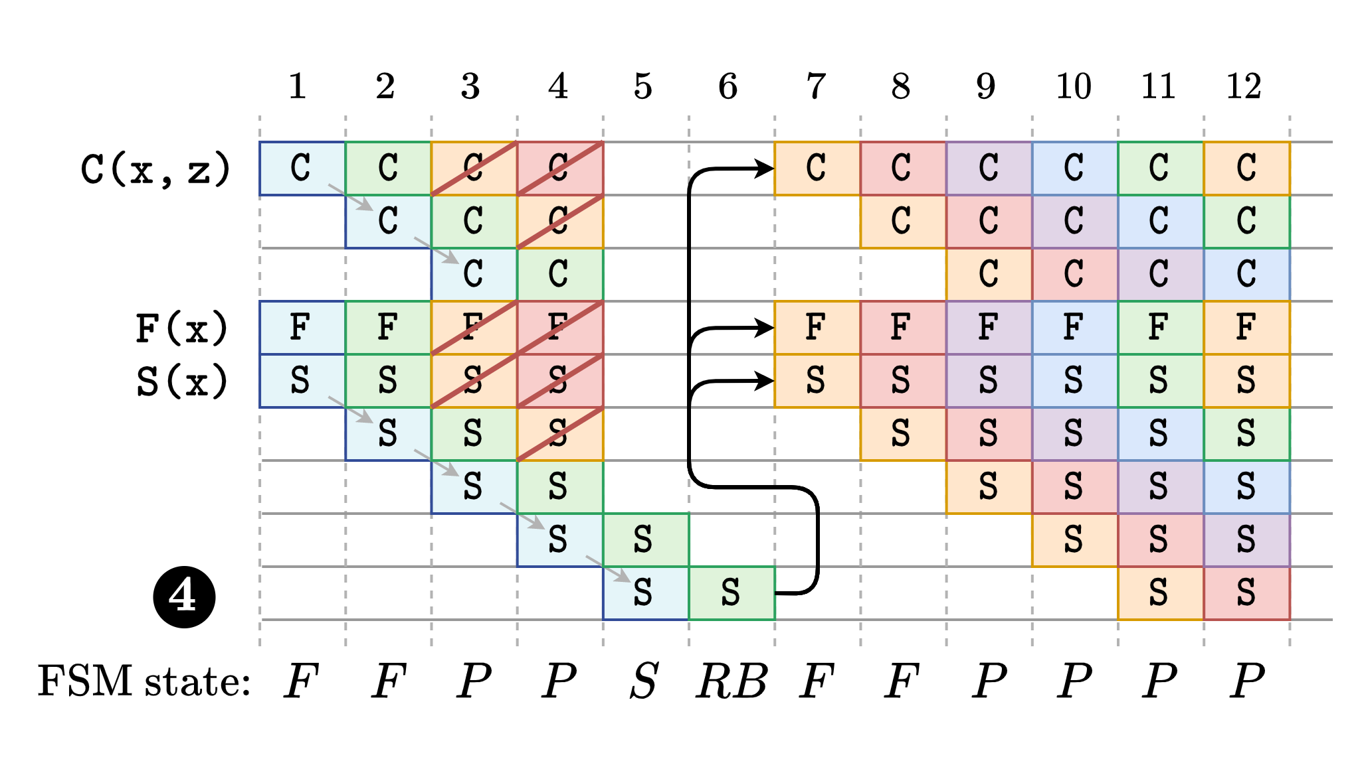
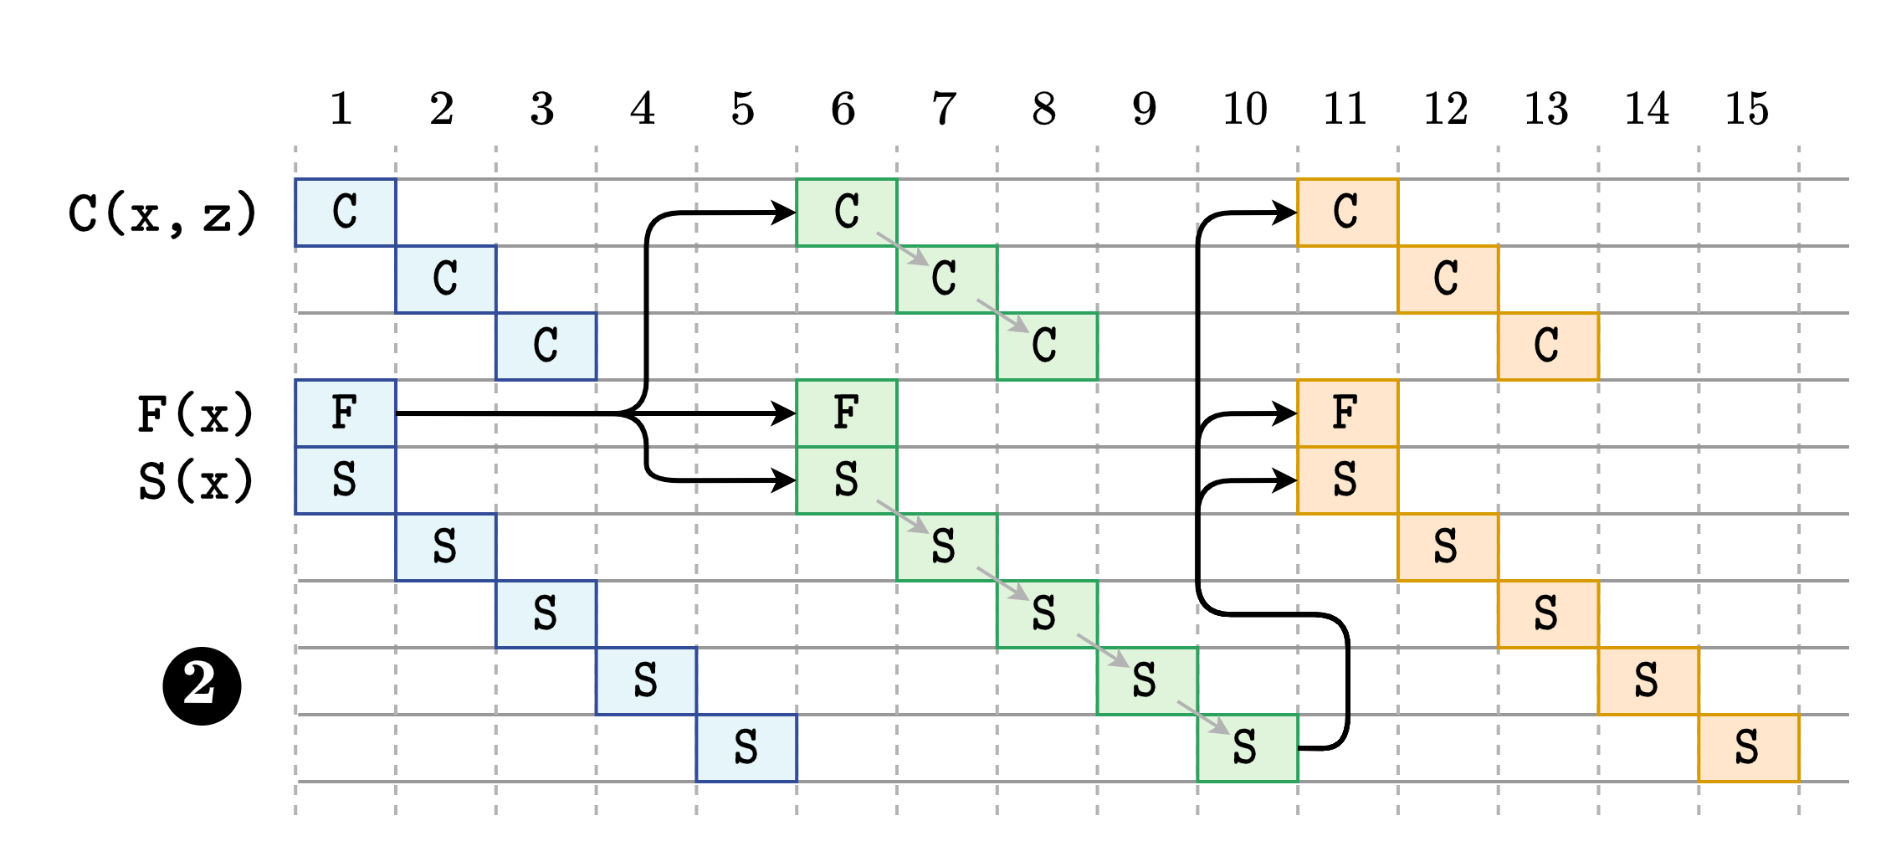
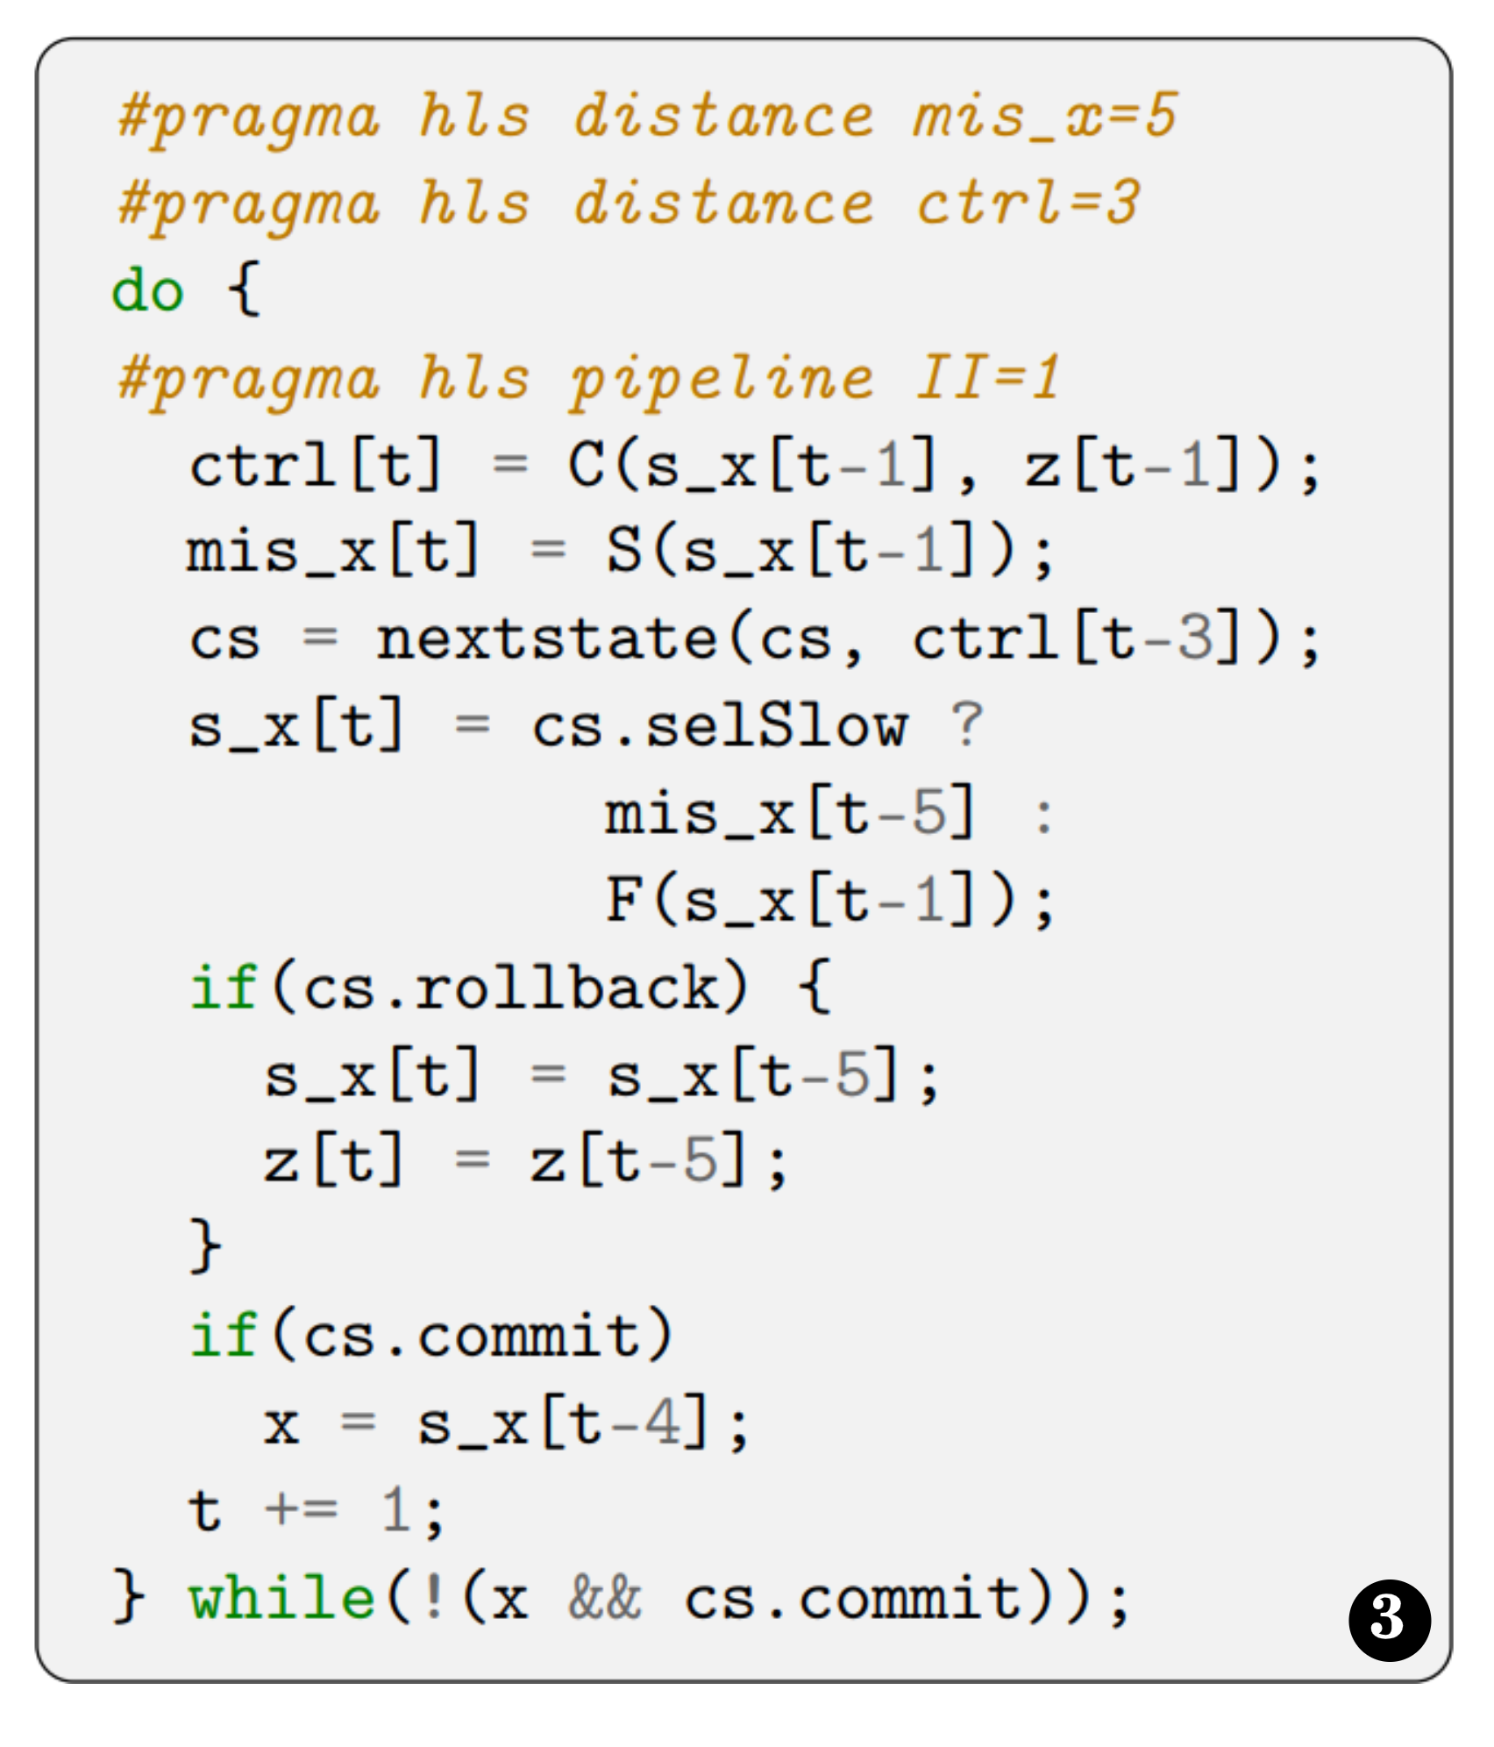
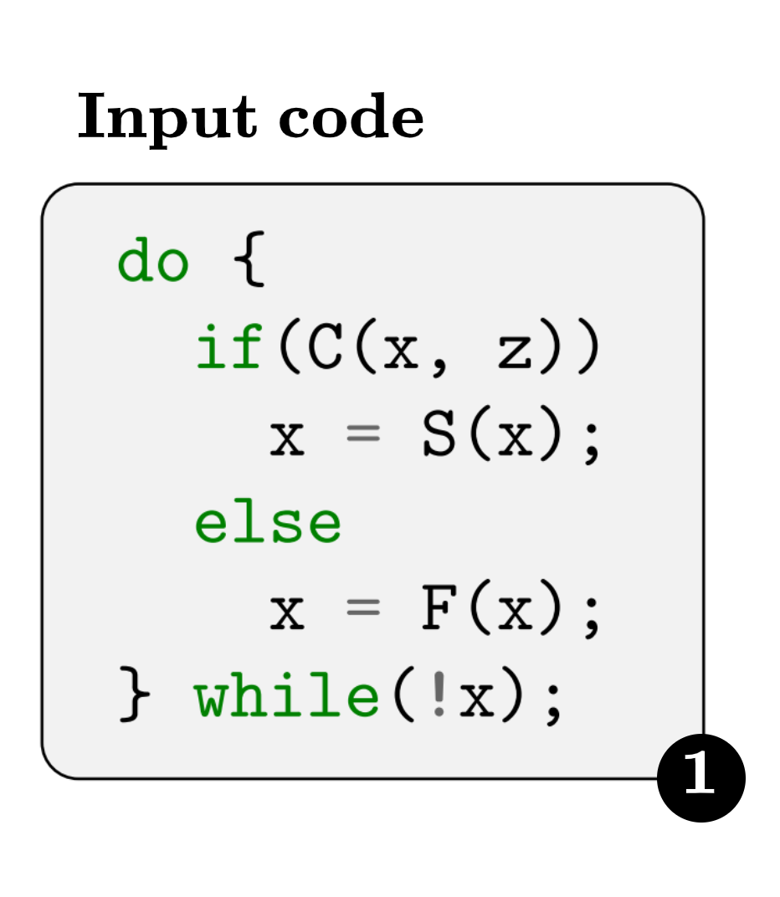
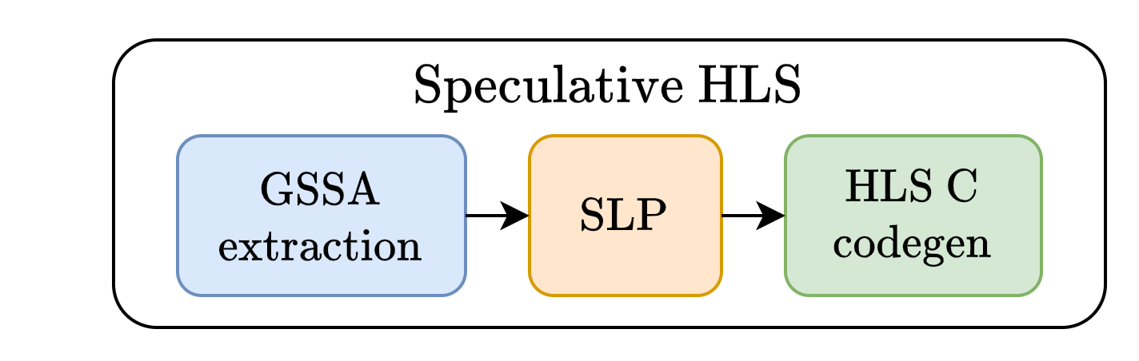
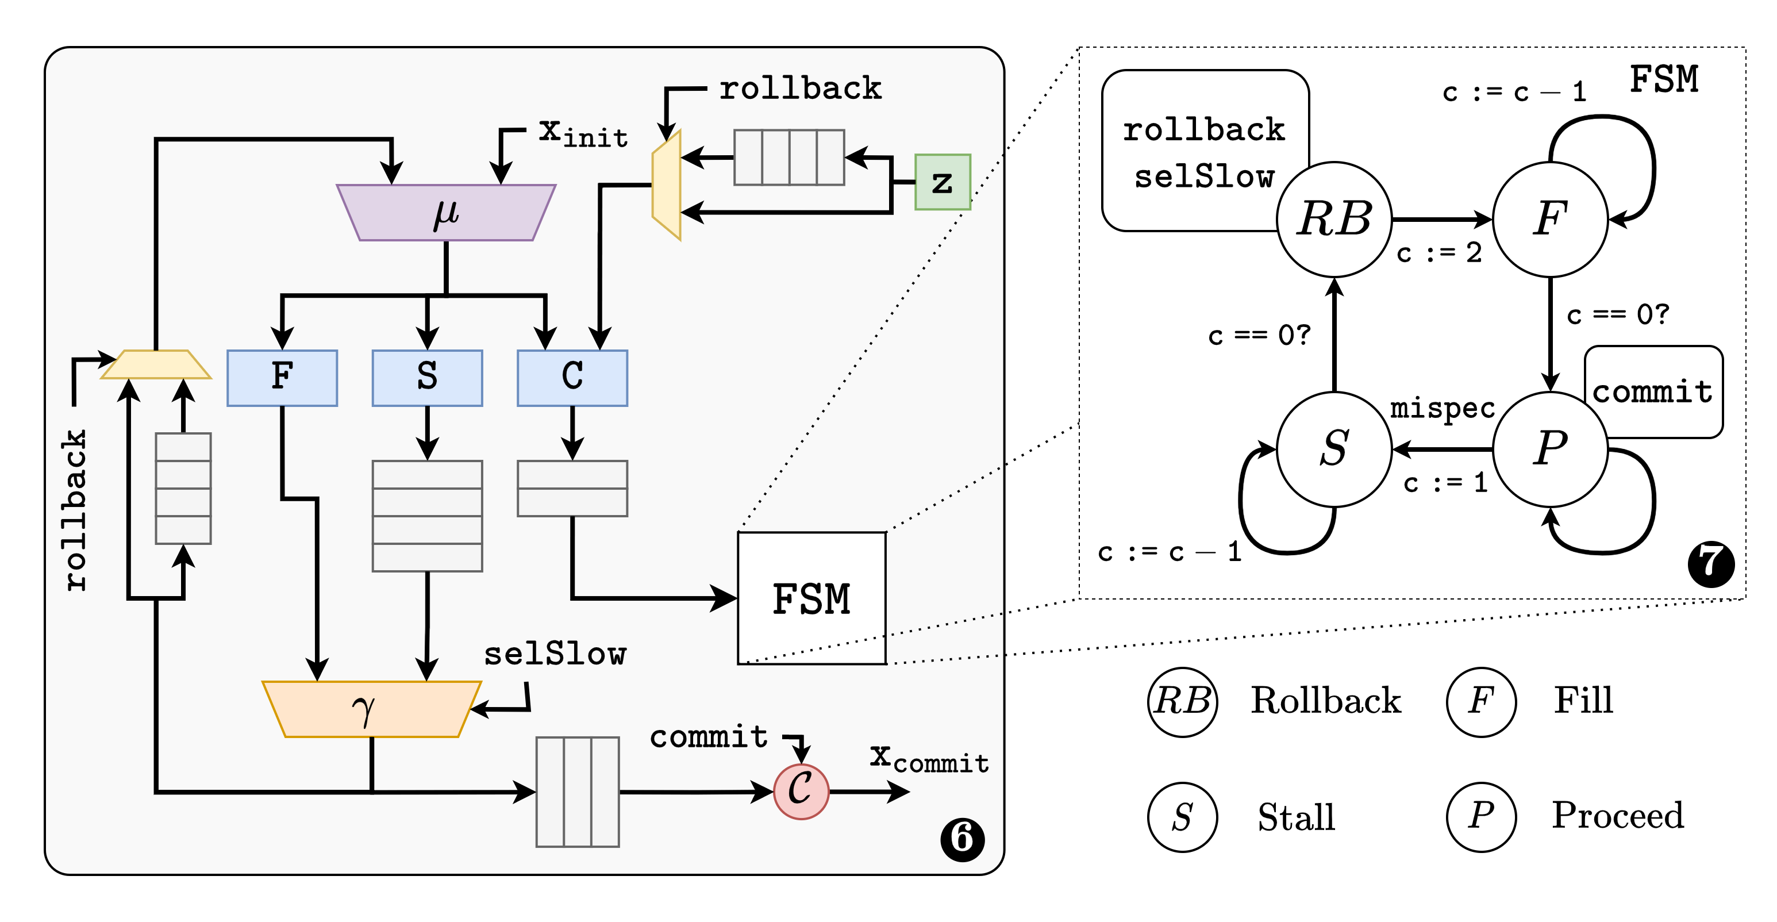
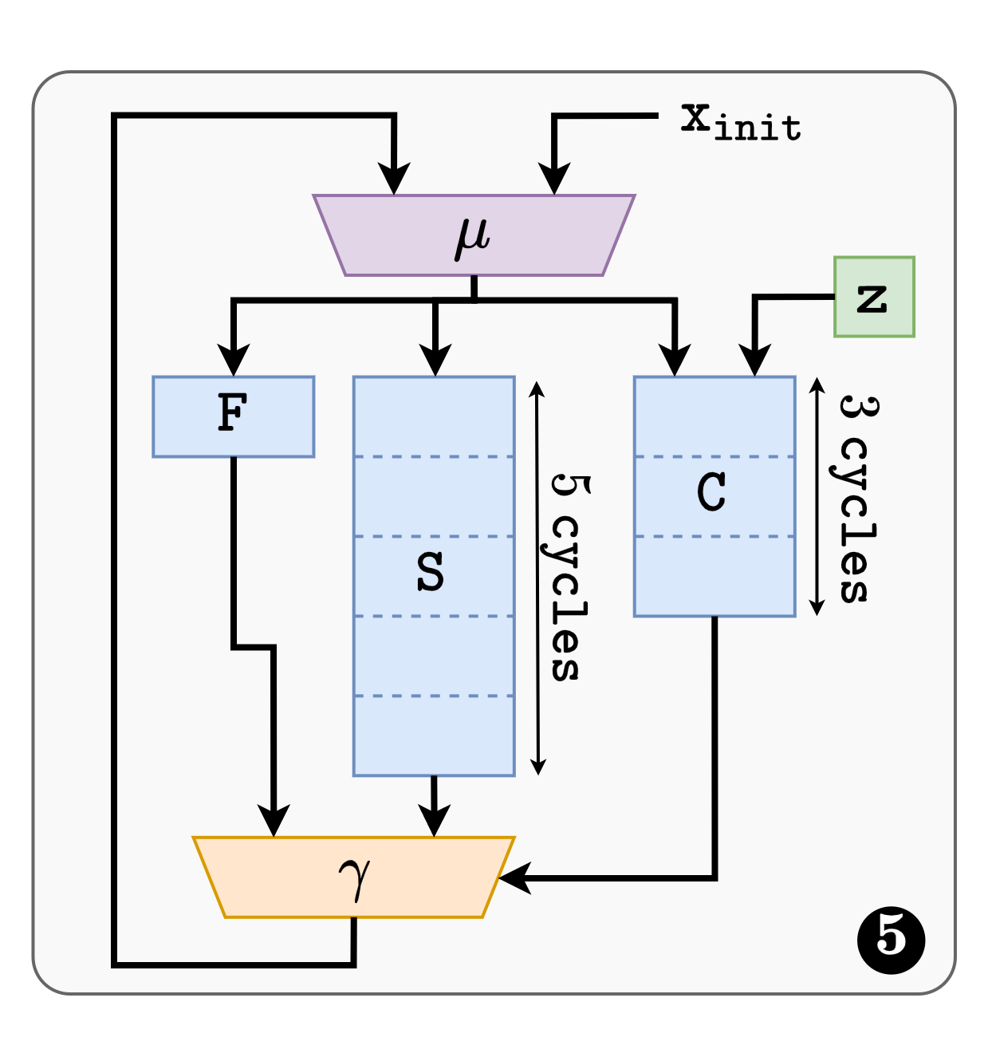
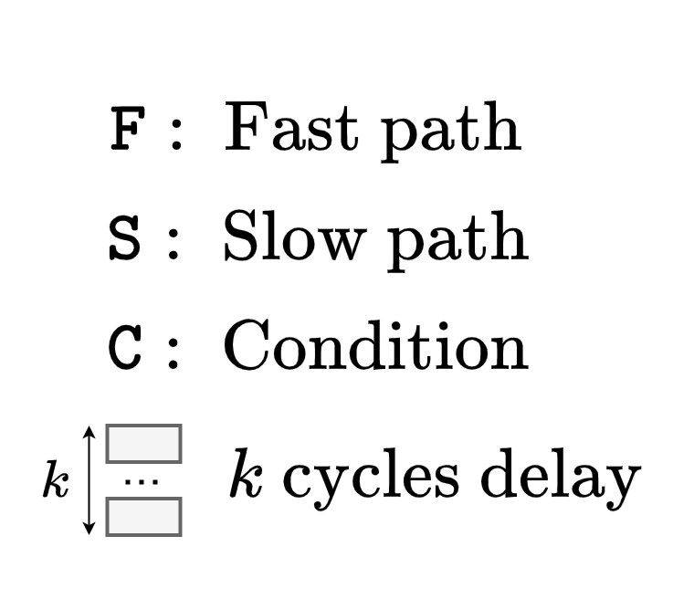
Inside the SLP transformation

Slide 23
Understanding SLP output
Expose reuse distance in the source code
do {
#pragma hls pipeline II=1
ctrl[t] = C (s_x[t-2);
mis_x[t] = S (s_x[t-3]);
s_x[t] = F (s_x[t-1],s_y[t-1]);
s_y[t] = H (s_x[t-1],s_y[t-1]);
cs = nextState(cs,ctrl[t]);
if (cs.rollback) {
s_y[t] = s_y[t-4];
s_x[t] = mis_x[t]
}
if (cs.commit) {
x = cs.sel? s_x[t-1]:mis_x[t];
y = s_y[t-1];
}
t++;
} while(!(x && cs.commit));
datapath with explicit pipeline reuse distance
1
2 stage pipeline for function C
H
control FSM
2
S
F
C
3 stage pipeline for function S
FSM
07/07/2022
Journée Calcul – GDR ISIS
Notes:
In this work, we perform the program transformation directly at the source level, using a source to source compiler.
The transformed source is not easy to understand, so we will review it step by step.
[NEXT]
The first step consists in introducing shadow variables s_x and s_y which we use to store the speculative versions of x and y.
The second steps aims at forcing the HLS tool to derive a pipelined datapath with specific pipeline depths. We therfore
need a way to specify the pipeline schedule depth directly in the source code. We achieve this by making the reuse distance explicit in the access patterns.
[NEXT]
For example, by using the access pattern s_x[t-2], we provide just enough slack for a two stage pipeline implementation of the function C. Similarly, the access pattern s_x[t-3] will enable a 5 stage pipeline implementation for S.
Of course this implementation is impractical as it requires infinite buffers. In practice, we use either delay lines (or circular buffers as in this example) [NEXT]
At this point, we have obtained a pipelined datapath, but we need to make sure it performs the same computations as the original code. More specifically, we have to detect and resolve mispeculations.
Step 2:
We embed the mispeculations management timing logic within a Finite State Machine which we describe in the next slide. This FSM takes as input the outcome of the current control predicate, and produces 3 output control signals.

Slide 24
Understanding SLP output
Manage mispeculations using additionnal logic
do {
#pragma hls pipeline II=1
ctrl[t] = C (s_x[t-2);
mis_x[t] = S (s_x[t-3]);
s_x[t] = F (s_x[t-1],s_y[t-1]);
s_y[t] = H (s_x[t-1],s_y[t-1]);
cs = nextState(cs,ctrl[t]);
if (cs.rollback) {
s_y[t] = s_y[t-4];
s_x[t] = mis_x[t]
}
if (cs.commit) {
x = cs.sel? s_x[t-1]:mis_x[t];
y = s_y[t-1];
}
t++;
} while(!(x && cs.commit));
datapath with explicit pipeline reuse distance
1
RB
RB
H
control FSM
2
S
F
C
branch mispeculation management (rollback)
3
FSM
commit step
4
exit condition
Commit
5
07/07/2022
Journée Calcul – GDR ISIS
Notes:
Step 3:
When a mispeculation occur, it is necessary to reinject the correct values from the slow path in the pipeline (in our case mis_x[t%3]), and rollback variables to a previous valid state (s_y[(t-4)%3] for variable s_y); This step occurs when the FSM asserts the cs.rollback field to true.
Step 4:
Once the speculation is known to be sucessfull, or after having recovered from a mispeculation, we can safely commit the speculative value to the actual variables x and y. This step occurs when the FSM asserts the cs.commit field to true.
Step 5:
We also make sure the loop exit condition is modified to filter out iterations where no new values are commited.

Slide 25
Running example
cnt/=0,
cnt:=cnt-1
sel=0
commit=1
rollback=1
ROLLB
FILL
cnt:=0
cnt=0
cnt=0
C₁ | C₂ | C₃ | C₄ | - | - | - | C₄ | C₅ | C₆
 | C₁ | C₂ | C₃ | - | - | - | - | C₄ | C₅
S₁ | S₂ | S₃ | S₄ | - | - | - | S₄ | S₅ | S₆
 | S₁ | S₂ | S₃ | - | - | - | - | S₄ | S₅
 |  | S₁ | S₂ | S₃ | - | - | - | - | S₄
 |  |  | S₁ | S₂ | S₃ | - | - | - | -
 |  |  |  | S₁ | S₂ | S₃ | - | - | -
STALL
ctrl,
cnt:=1
RUN
sel=1
commit=1
cnt/=0,
cnt:=cnt-1
datapath
F₁ | F₂ | F₃ | F₄ | - | - | F₃ | F₄ | F₅ | F₆
H₁ | H₂ | H₃ | H₄ | - | - | H₃ | H₄ | H₅ | H₆
_{FILL} | _{RUN} | _{RUN} | _{RUN} | _{STALL} | _{STALL} | _{ROLLB} | _{FILL} | _{RUN} | _{RUN}
FSM
rollBack
commit
x₁
y₁
x₂
y₂
x₃
y₃
commit
Notes:
To better understand how the kernel behaves we will simulate its operation on a simple example.
[Next]
To do so, we will use the control FSM whose transition diagram is depicted on the top of the slide.
To avoid confusion, we will make the difference between iterations from the original loop (which we will refer to as « iteration ») from iterations from the transformed loop, which we will call time steps.
[NEXT] [NEXT]
In this scheme the loop execution starts in the FILL state, and [NEXT] speculatively assumes the fast branch to be taken.
This enables the next loop iteration to start in the next time step.
Since the control condition is implemented as a two stage pipeline, the pipeline enters its steady state during this second time step, and the FSM then switches to the RUN state. The first speculation is then resolved. [NEXT] [NEXT] Since no mispeculaton occured, the correct values of x and y are commited from the fast path. [Next]
As for the first iteration, we again speculatively assume the fast branch is taken, and proceed to the third time step, where we resolve the second iteration control condition. [Next][Next] Here again, no mispeculation occured and we commit new values for x and y.
The situation is different at the fourth time step, as a mispeculation occured while starting the fourth loop iteration [Next]. As a result, we must discard the current computations [Next], and stall until we proceed through the five stages of the slow path. [NEXT] [NEXT] [NEXT]
Once we reach the fifth pipeline stage for function S, we switch to the rollback state, where we rollback s_y to its last valid value, [Next] and commit the output of S for x [Next]
From there, we loop back to the FILL state and reinitiate our speculative pipeline scheme.
(3 minutes)

Slide 26
Outline
High Level Synthesis in a nutshell
Loop pipelining in High Level Synthesis
The case for dynamic & speculative pipelining
Overview of SpecHLS
Performance evaluation & results
Conclusion & ongoing work

Slide 27
Performance evaluation
Evaluated on Vitis HLS, targeting an XU280 FPGA.
  Impact of T_{clk}, area and overall performance
Over a (cherry picked) set of relevant kernels
  Image gridding
  Hmmer profile search
  RISC-V synthesis

Slide 28
Hmmer
Profile based sequence search in bioinformatics
  Almost parallel algorithm (due to a max operation)
~7x speed
~2x area

Slide 29
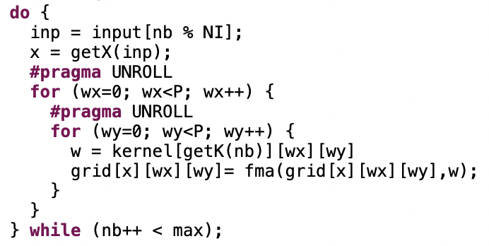
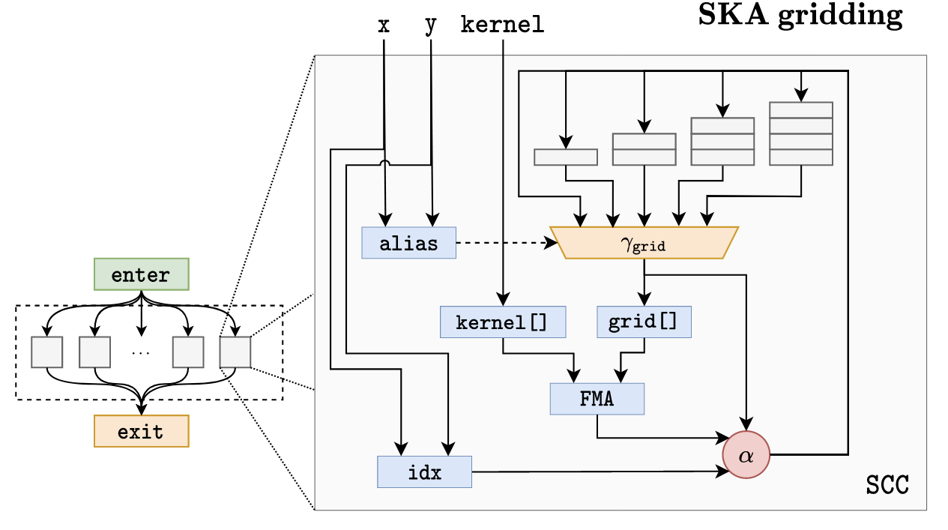
Image gridding
x
[x]
[x]
~8x speed
~13x area

Slide 30
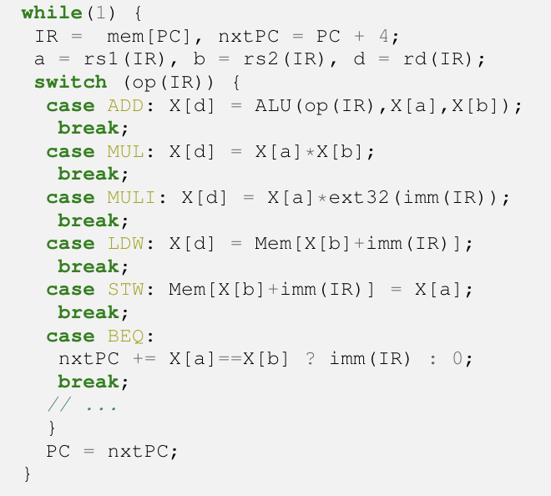
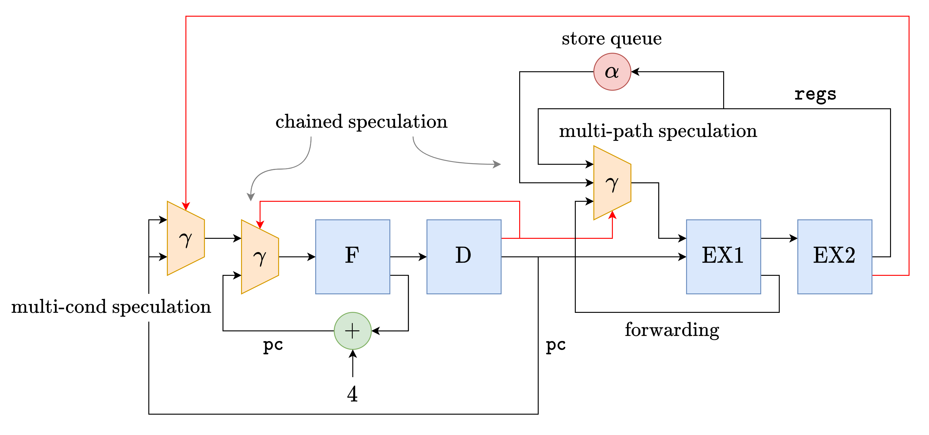
Synthesizing RISC-V cores from ISSs
Instruction Set Simulator = behavioral description
Data-flow speculation
Control flow speculation
07/07/2022
Journée Calcul – GDR ISIS

Slide 31
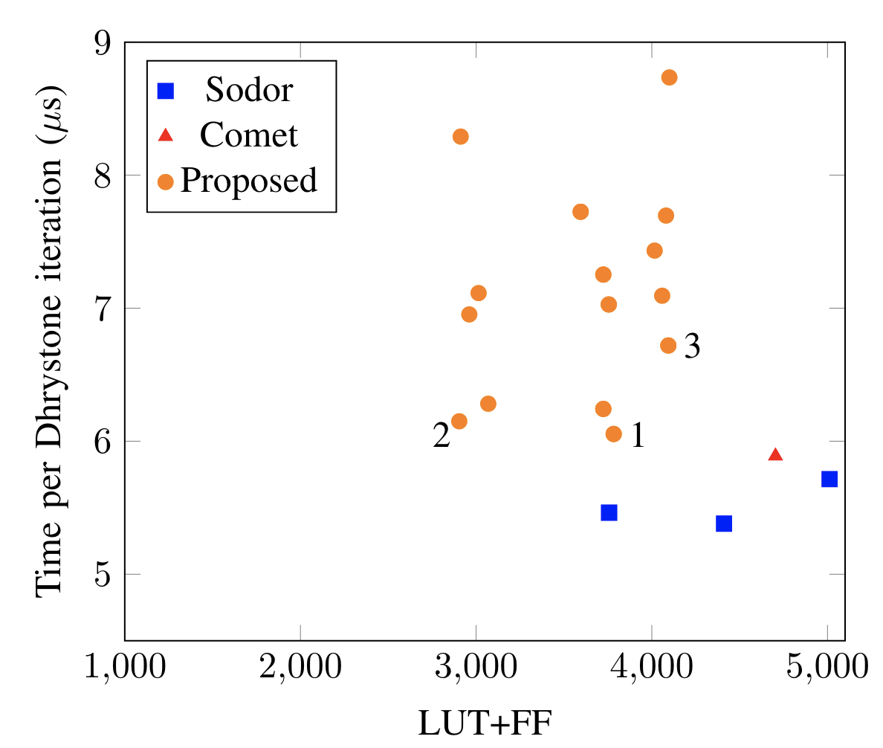
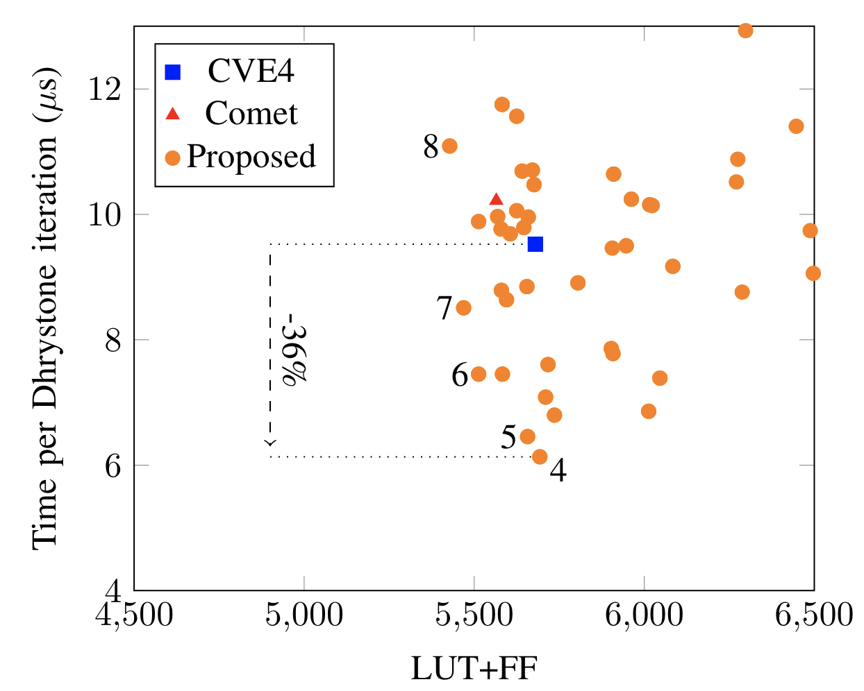
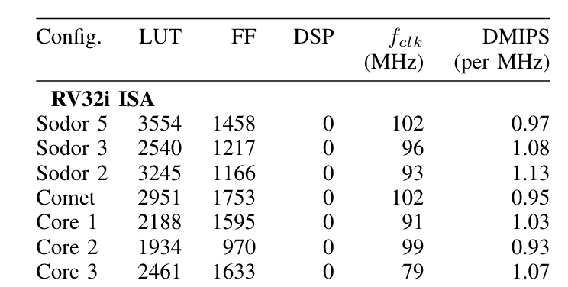
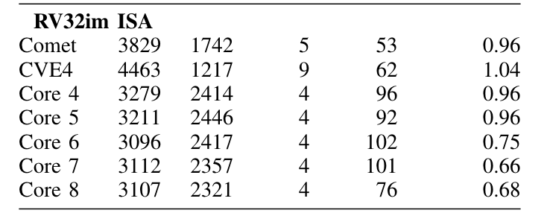
First results (Artix7)
RISCVI32
RISCVIM32

Slide 32
Outline
High Level Synthesis in a nutshell
Loop pipelining in High Level Synthesis
The case for dynamic & speculative pipelining
Overview of SpecHLS
Performance evaluation & results
Conclusion

Slide 33
Conclusion
An approach for speculative loop pipelining for HLS
  As a program transformation build on top on static pipelining
Supports complex hazard management
  Milestone : synthesis of a full pipelined CPU from its ISS
Beware : there is a verification challenge ahead
  Formal verification techniques are probably needed
07/07/2022
Journée Calcul – GDR ISIS
Notes:
What we have proposed in this work is a first step toward speculative loop pipelining in HLS.
The main originallity of our approac is that we implement speculative pipelining as a program transformation performed ahead of the HLS static loop pipelining stage. This is different from previous work which try to address the problem at the back-end stage using customized RTL back-ends. Because of this, we expect our approach to be much easier to integrate within existing HLS frameworks.
In the future, we would like to explore more complex pipeline hazards management strategies, with the goal of having a fully automated design space exploration tool. A milestone would be to automaticaly infer a pipelined CPU design directly from its complete ISS.
Even if we succeed doing so, using this type of technique raises a significant verification challenge, our belief is that formal verification methods will be mandatory.
Thank you for your attention and see you at the live session.

Slide 34
The big picture
Modeling speculative execution
Custom speculation mechanisms
Represent speculation at the compiler level
Toward domain specific speculation
Compilation
Computer-Aided Design
Micro-architecture
Design Space Exploration
Explore very large design space

Slide 35
Backup slides

Slide 36
Related Work
Results as good as those obtained by Josipovic et al.
Seamless integration within HLS frameworks
 | Loop Pipelining | Control Speculation | Memory Access Disambiguation | Program Level
Holtmann and Ernst (1995) | ✔✔︎✔︎✔︎✔︎✔︎ | ✔✔︎✔︎✔︎✔︎✔︎
Gupta et al. (2003) |  | ✔✔︎✔︎✔︎✔︎✔︎
Lapotre et al. (2013) |  | ✔✔︎✔︎✔︎✔︎✔︎
Alle et al. (2013) | ✔✔︎✔︎✔︎✔︎✔︎ |  | ✔✔︎✔︎✔︎✔︎✔︎✔✔︎✔︎✔︎✔︎✔︎ | ✔✔︎✔︎✔︎✔︎✔︎
Dai et al. (2017) | ✔✔︎✔︎✔︎✔︎✔︎ |  | ✔✔︎✔︎✔︎✔︎✔︎
Josipovic et al. (2019) | ✔✔︎✔︎✔︎✔︎✔︎ | ✔✔︎✔︎✔︎✔︎✔︎ | ✔✔︎✔︎✔︎✔︎✔︎
Our Approach | ✔✔︎✔︎✔︎✔︎✔︎ | ✔✔︎✔︎✔︎✔︎✔︎ | ✔✔︎✔︎✔︎✔︎✔︎ | ✔✔︎✔︎✔︎✔︎✔︎
Speculation + Dataflow
GDR SOC
Notes:
In 1995, Holtmann and Ernst have proposed an approach combining control flow speculation and loop pipelining, but they do not provide any synthesis data, so it is hard to compare. Besides, control flow speculation alone is often not enough for programs that involve arrays, limiting the scope of applicability.
More recently, there has been work on better managing memory aliasing to improve loop pipelining.
The work by Josipovic and others last year combines both forms of speculation and can handle wider range of programs than before. Although the outcome by their approach is similar to ours in terms of performance, the key difference is that they rely on a dataflow architecture. Our approach operates at the source-level, sharing the same model of execution as HLS tools, and can seamlessly integrate into HLS workflow.

Slide 37
Side benefits : simulation speed
Native speed cycle accurate simulation for free
  Transformed code tracks actual/true cycle count (variable t)
  Run C code and monitor values of t and true loop trip count i
Makes Design Space Exploration easier
  Enables early exploration of speculation scenarios
do {
…
if (cs.commit) {
i++;
…
}
t++;
} while(!(x && cs.commit));
Original loop counter
Speculative loop counter
Notes:
[1’30]
In addition to the performance improvements offered by speculation, which we will discuss later, implementing the transformation at the program level has several other benefits.
First, we can perform early, cycle accurate performance estimate at native speed by directly running the transformed program.
[Next]
This is because the transfomed C code captures the speculation timing penalties through the t variable in the code.
Thanks to this, Desigh Space Exploration is greatly simplified, and it is possible to quickly explore different speculation strategies by choosing more or less aggressive speculation depth, this later parameter being a design constant.

Slide 38
Why SLP matters ?
SLP enables memory speculation
  Generalizes several prior techniques [Alle13, Dai17]
do {
rd_ad = rand();
wr_ad = rand();
if(rd_ad == d_wr_ad) {
in = v;
} else {
R: in = tab[rd_ad];
}
E: v = Foo(in);
W: tab[wr_ad] = v;
d_wr_ad = wr_ad;
}
#pragma memdep tab distance=2
do {
rd_ad = rand();
wr_ad = rand();
R: in = tab[rd_ad];
E: v = Foo(in);
W: tab[wr_ad] = v;
} while(…);
slow path
fast path
Data dependant memory dependency
(dep. distance =1)
Notes:
[1’30]
There are many situation where loop pipeline is not limited by control-flow, but by complex memory access patterns that cannot be statically determined.
[Next]
This is for example the case in the example below, where the loop exposes a RAW loop-carried dependency on the array tab. This dependency may manifest at every iteration, and therefore prevents pipelining.
[Next]
It is however possible to check at runtime whether the dependency actually holds, and use this information to expose a more favorable execution path in the code.
[Next]
This is illustrated on a transformed version of the code
[Next] [Next]
... where the load is executed speculatively
[Next] [Next]
and where we isolate the case where the loop carried dependency manifests within a (hopefully infrequent) distinct slow path.
We then simply let the SLP pass take advantage of this speculation opportunity.
[Next]
In other words, we now use the SLP transformation as a back-end of another program transformation. We believe this is an important insight as it opens the door many others type of speculation.

Slide 39
Why SLP matters ?
Using customized caches for irregular access patterns
do {
addr = offset(res);
if (tag(ad)!=cache[set(ad)].tag) {
data = mem[addr];
cache[set(ad)].data =data;
cache[set(ad)].tag = tag(addr);
} else {
data = cache[set(addr)].data;
}
res = foo(res,data);
} while (…)
do {
addr = offset(res);
data = mem[addr];
res = foo(res,data);
} while (…)
slow path
(miss)
fast path
(hit)

Slide 40
Why SLP matters ?
Enabling speculative algorithms/operators ?
In some specific cases, floating point accumulation can be simplified to a shift and add.
float acc;
do {
data = …
acc += data
} while (…)
float acc;
do {
data = …
if (acc.E>(data.E+4) &&
(data.M[23:20]!=0xF) {
acc.M += data.M >> (acc.E-data.E);
} else {
acc += data;
}
} while (…)

Slide 41
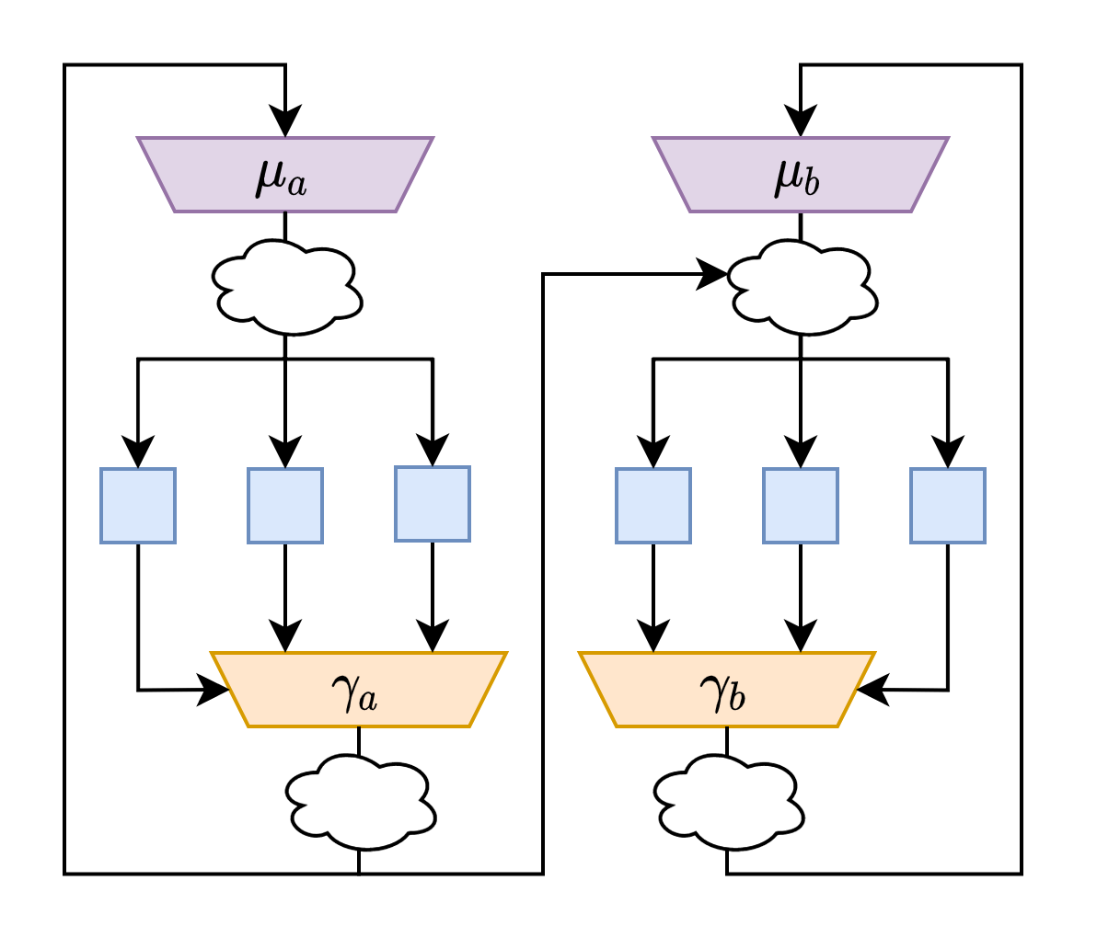
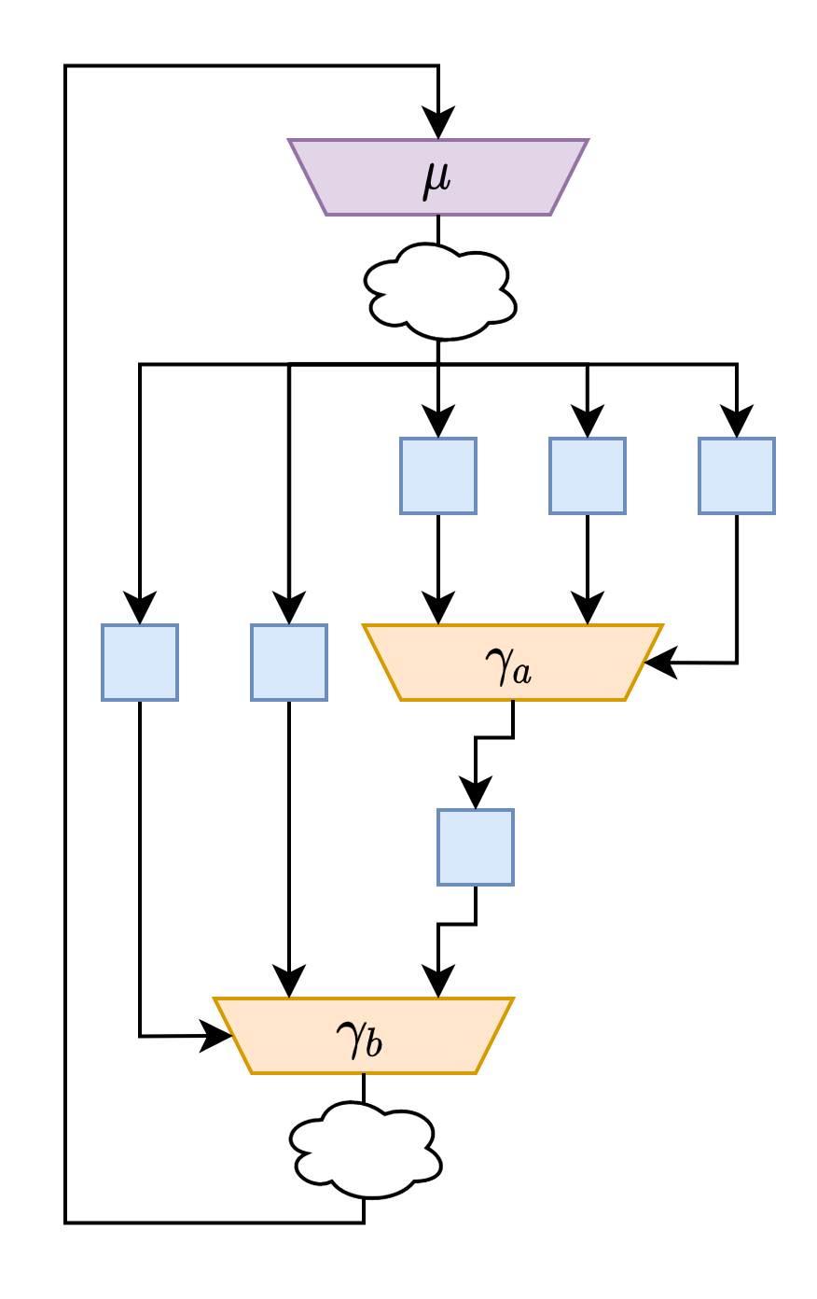
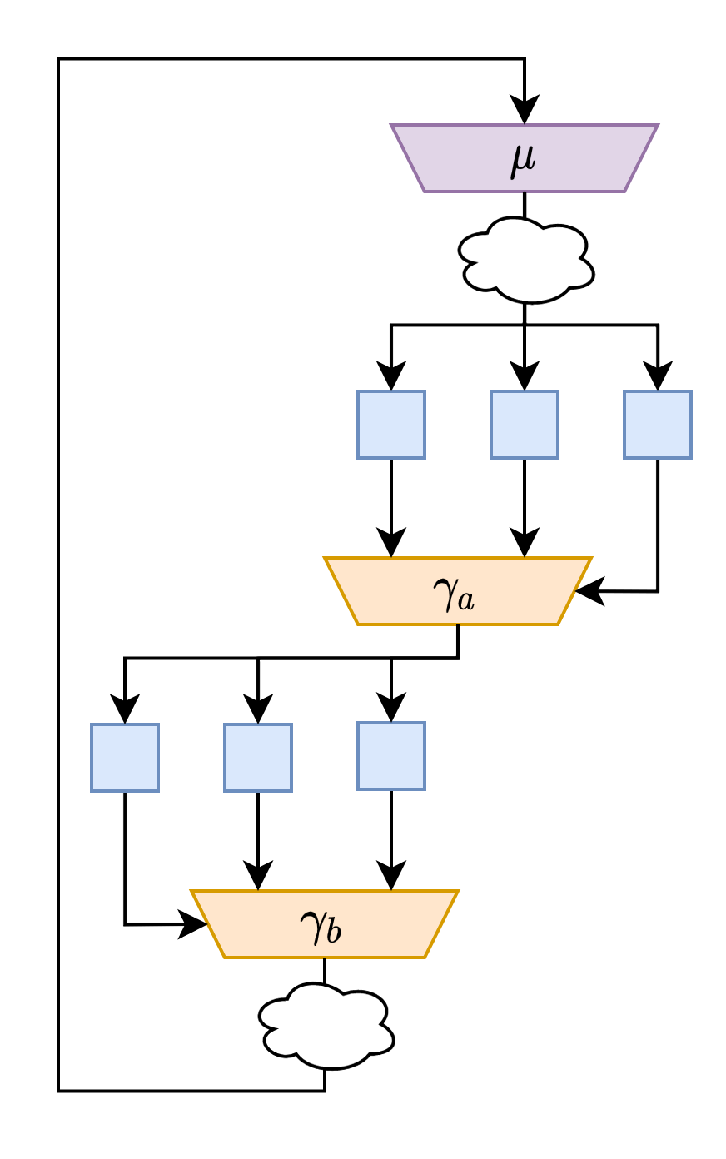
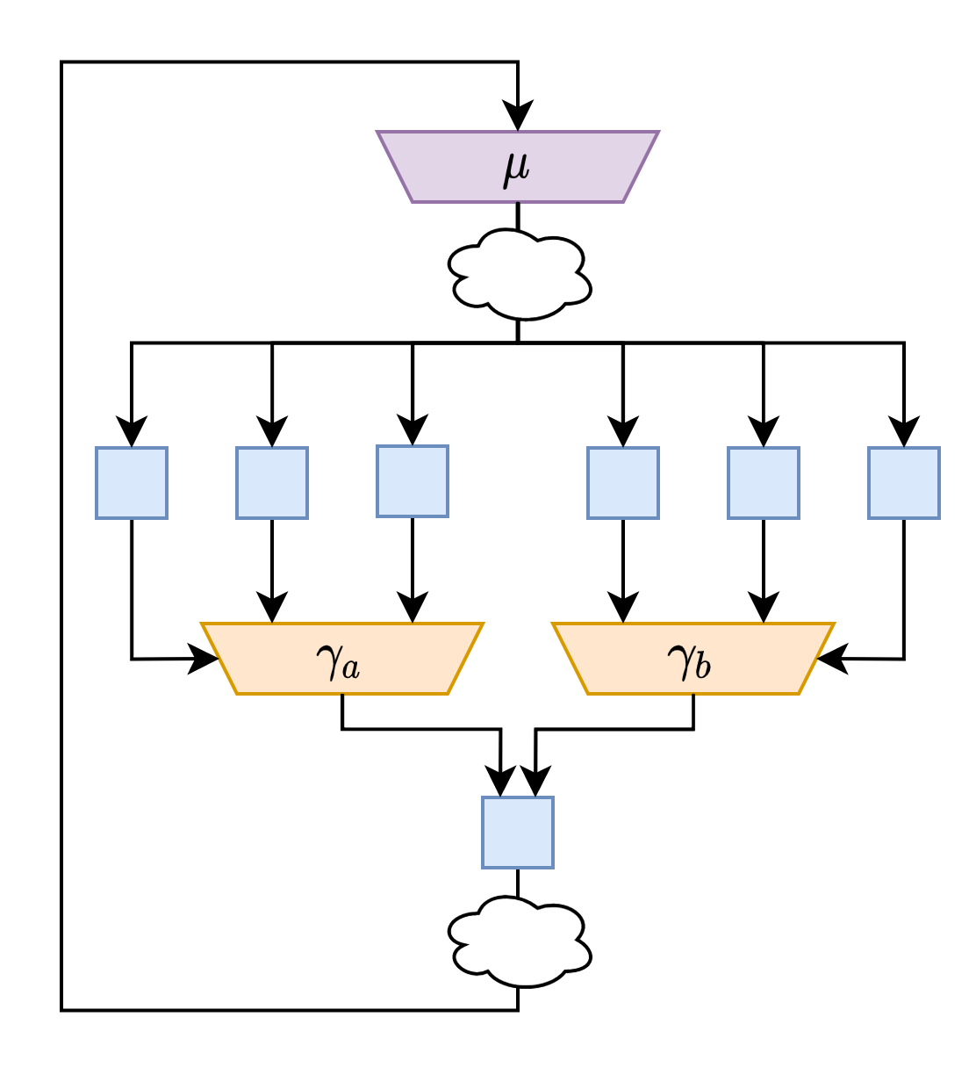
Handling multiple speculations
Based on interaction patterns between speculations
One type of FSM per speculation pattern
Decoupled speculations
Independant speculations
Data dependant speculations
Control dependant speculations

Slide 42
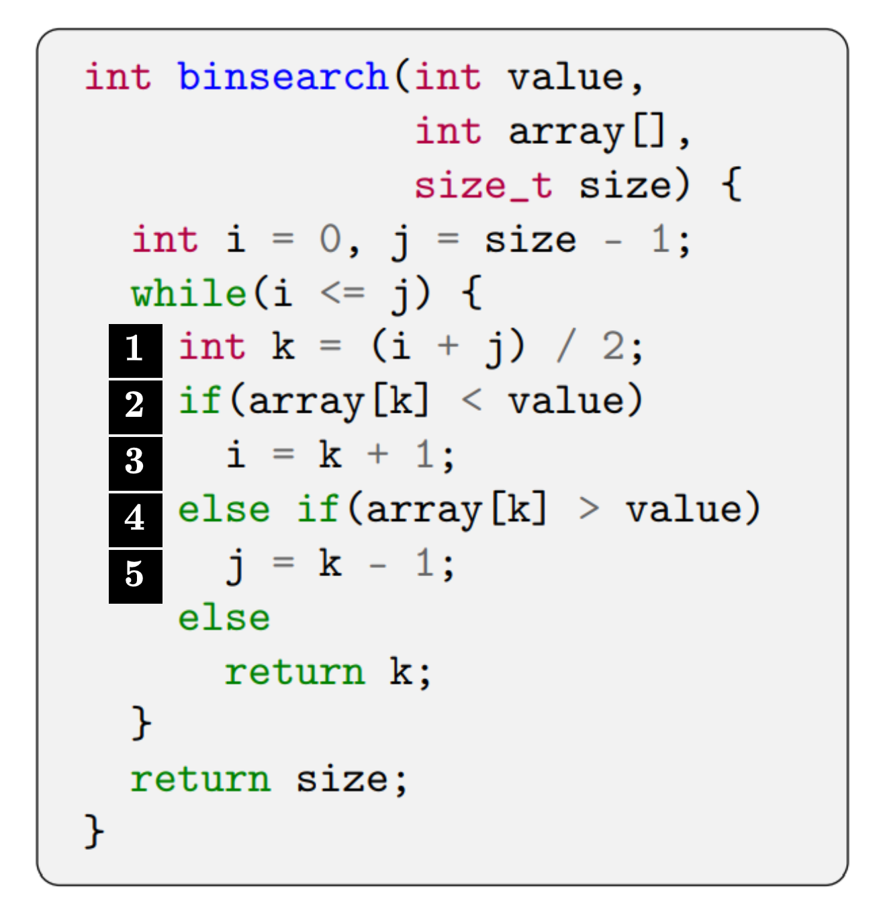
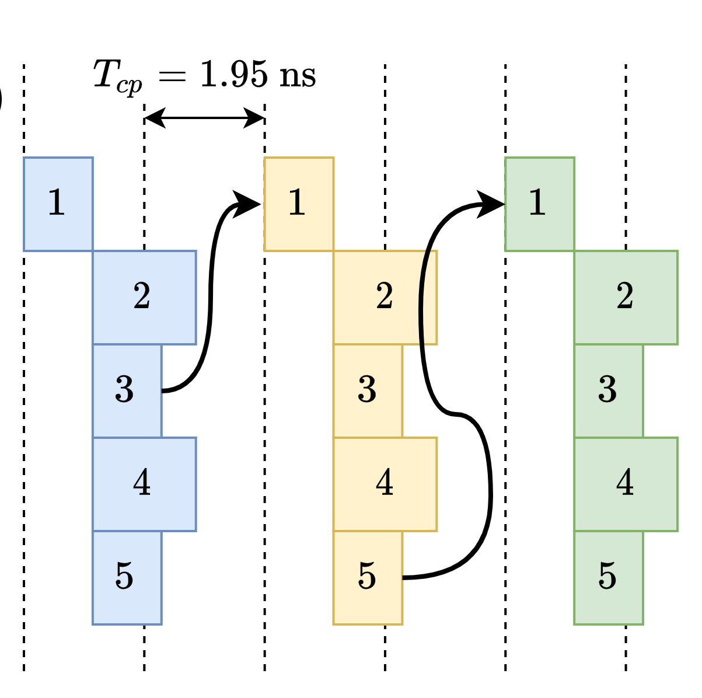
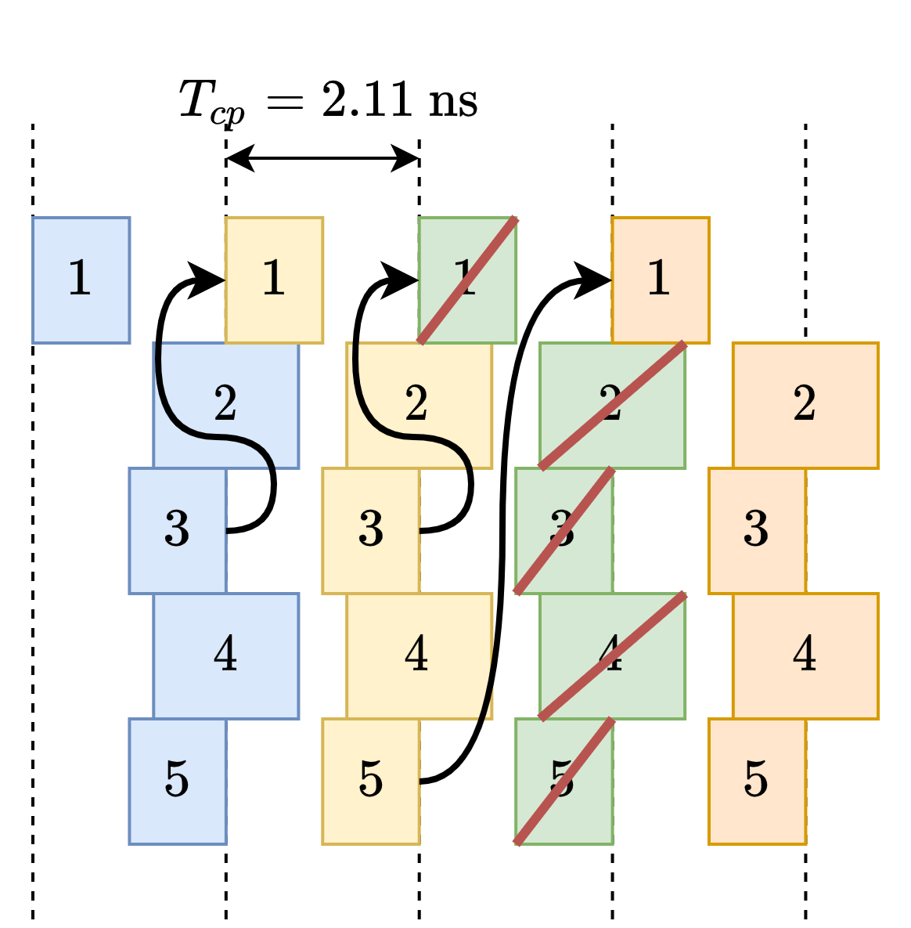
Example
Baseline
Speculative
50% mispeculated
CPI=2
T_{clk}=1.95ns
~260 MItPS
CPI=1.(50%) +2.(50%))
T_{clk}=2.11ns
~300 MItPS

Slide 43
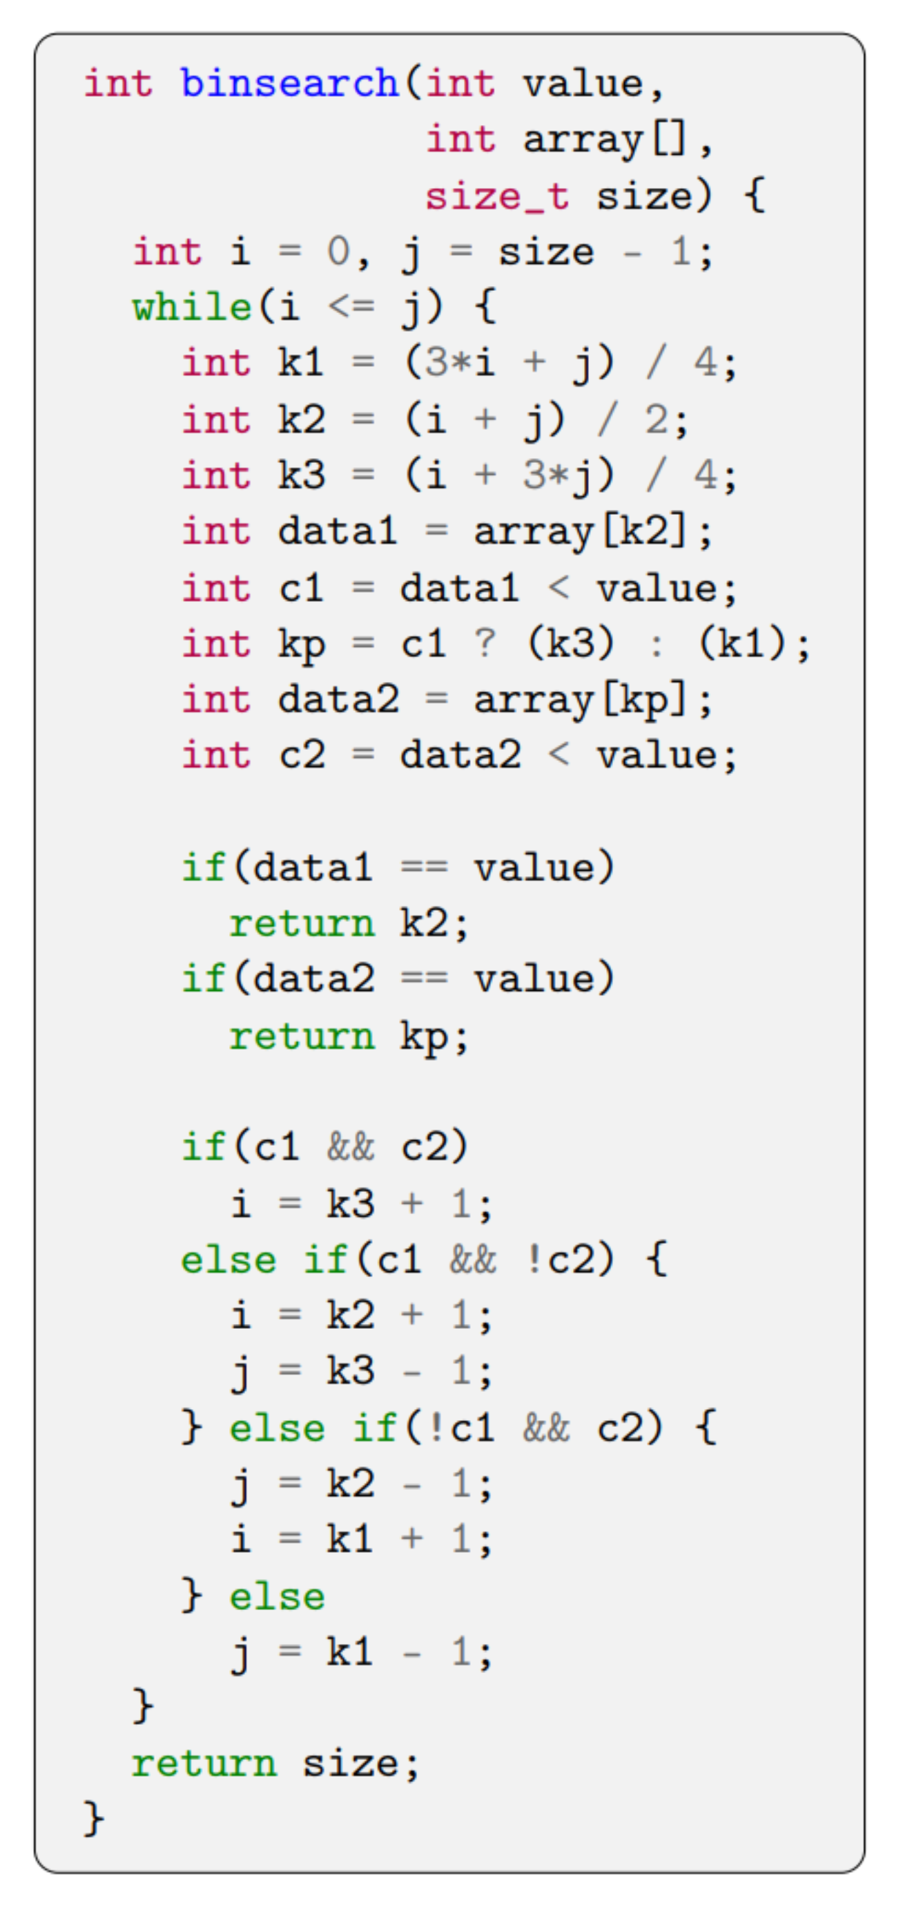
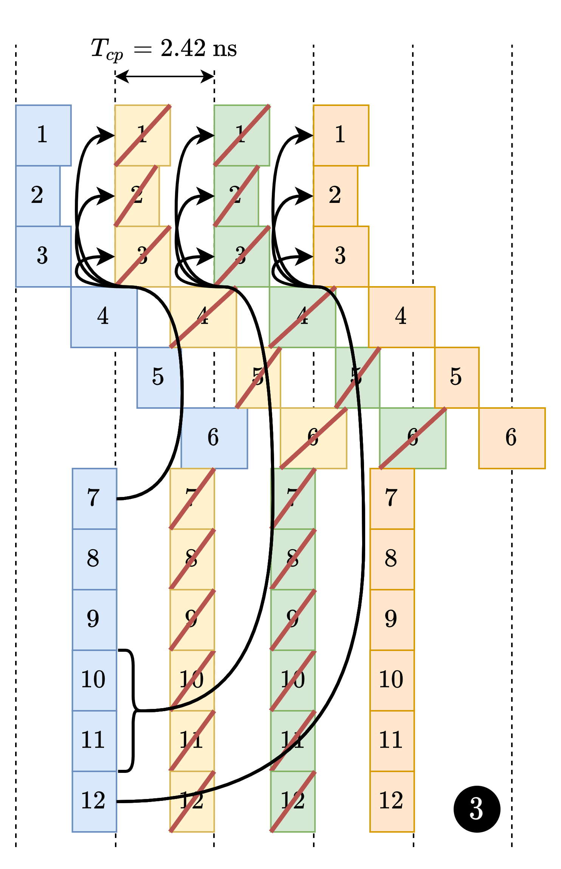
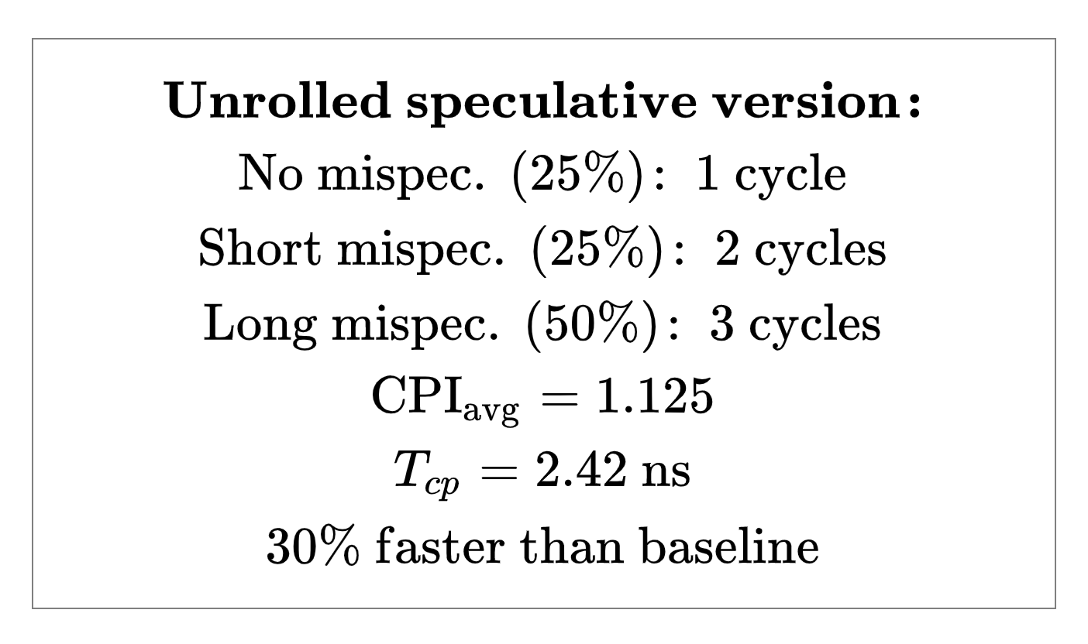
More speculation …

Slide 44
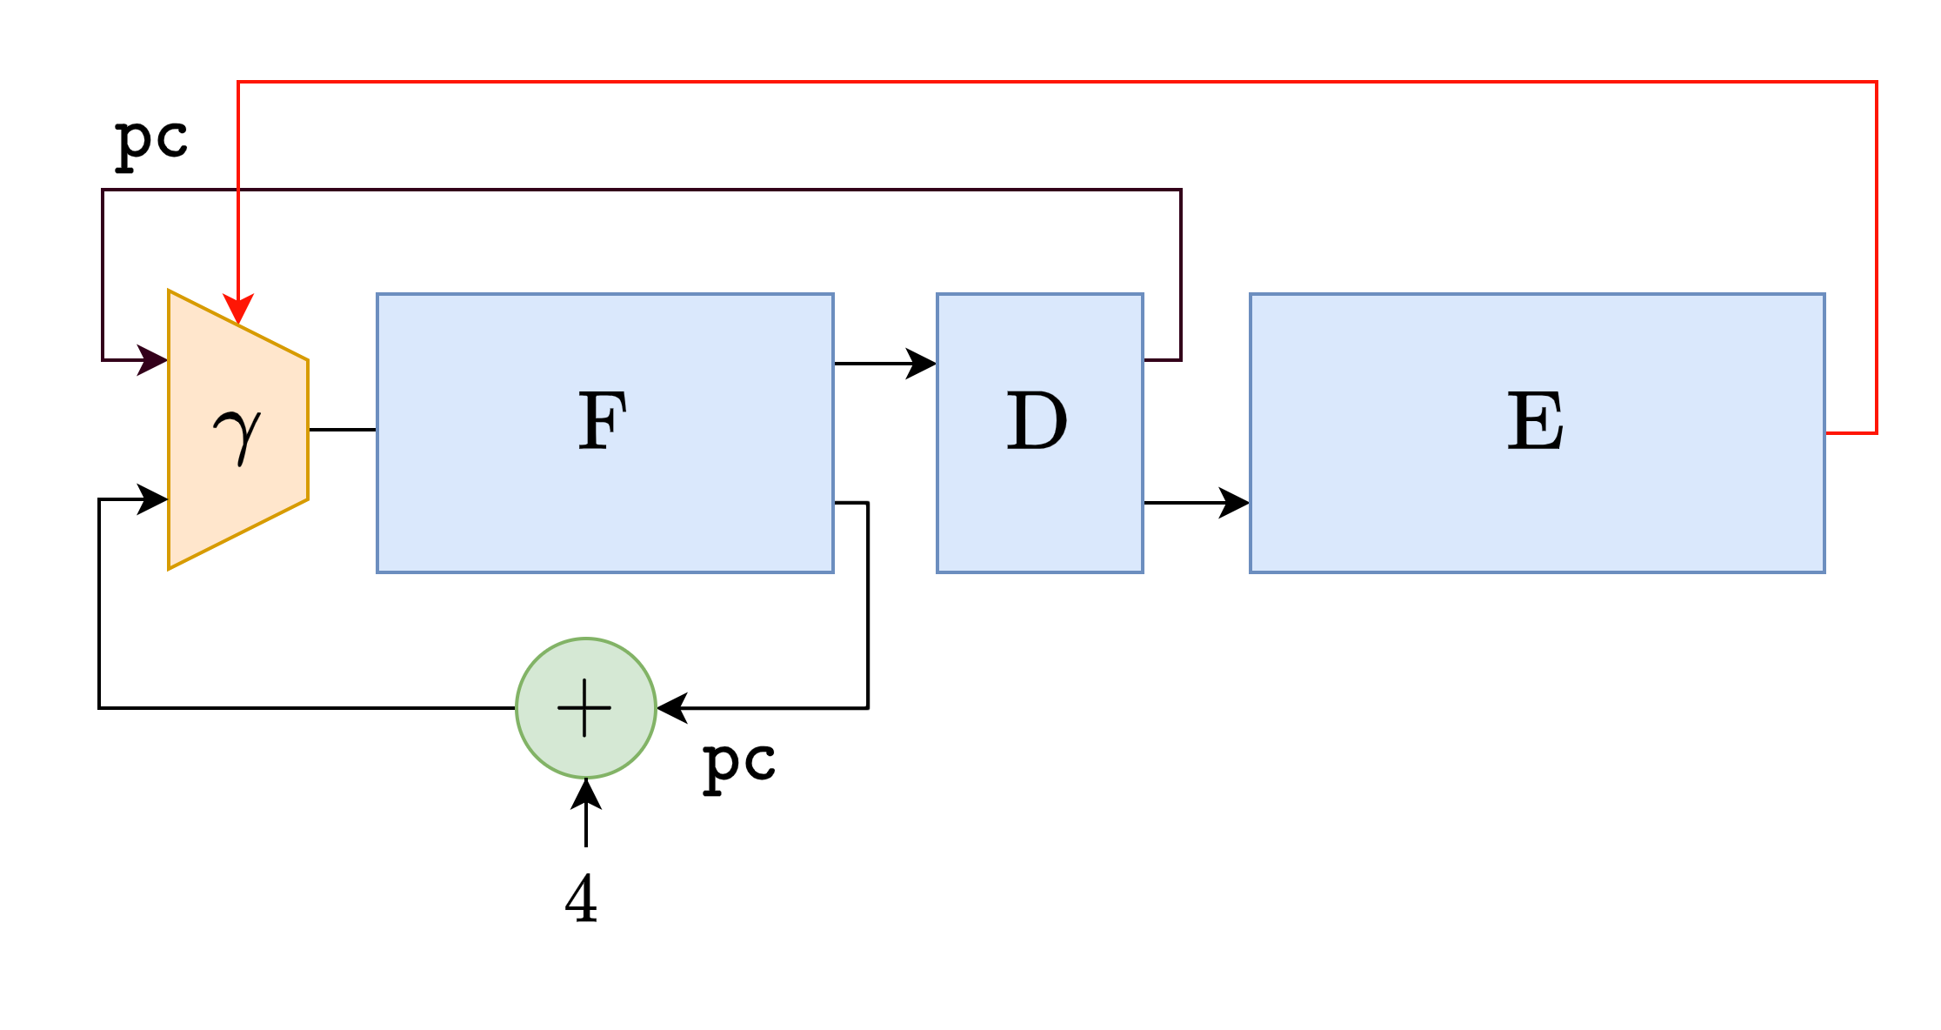
Pipeline depth exploration
do {
ir = F (pc);
{op,reg} = D (ir);
{pc,reg} = E (op,reg);
} while(1);
do {
#pragma hls pipeline II=1
ir[t] = F(pc[t-1);
opc[t] = D(ir[t]);
s_pc[t] = E(opcod[t-1],pc[t-1]);
….
fsm_v1()
} while(1);
do {
#pragma hls pipeline II=1
ir[t] = F(pc[t-2);
opc[t] = D(ir[t-1]);
s_pc[t] = E(opcod[t-2],pc[t-5]);
….
fsm_v2()
} while(1);
Each version has its own hazard mngt logic
3 stages
6 stages
Pipeline balancing achieved using the HLS tool loop pipelining back-end

Slide 45
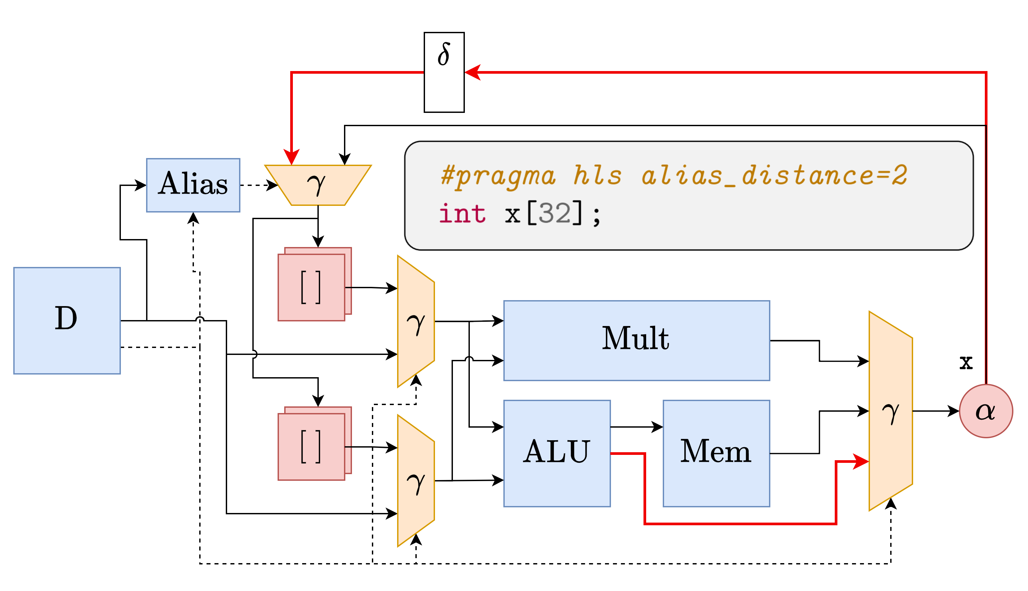
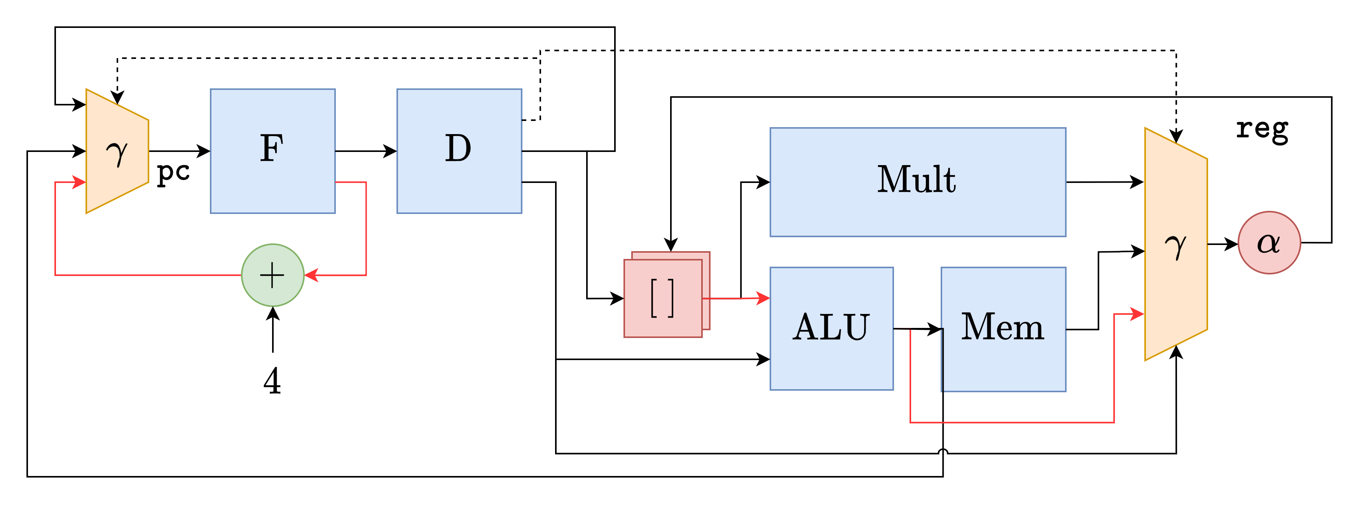
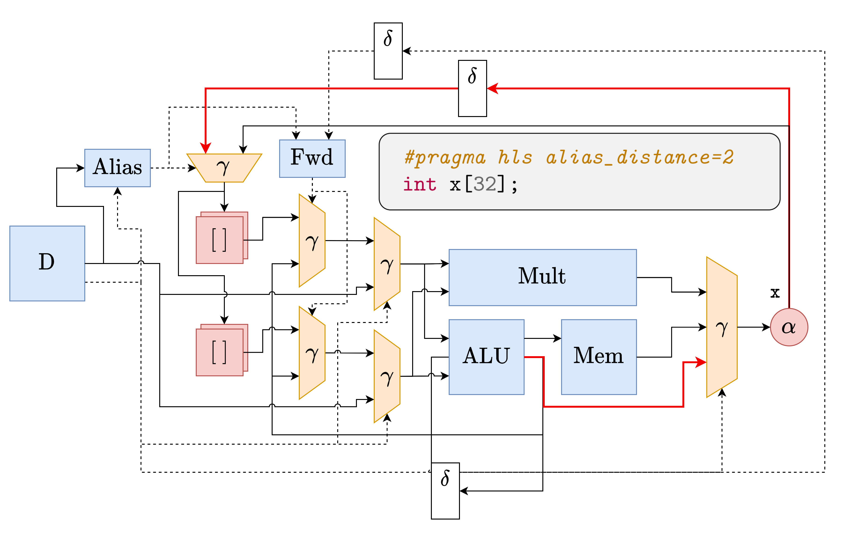
Modeling complex μarch features
Interlocking
Forwarding

Slide 46
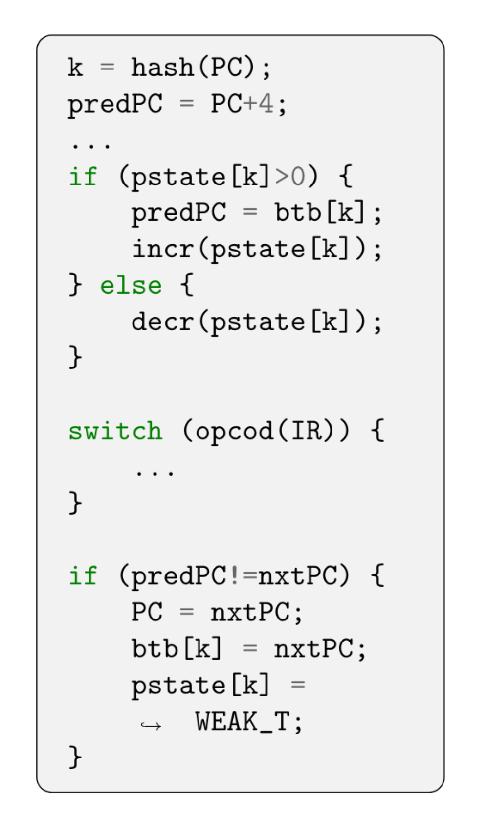
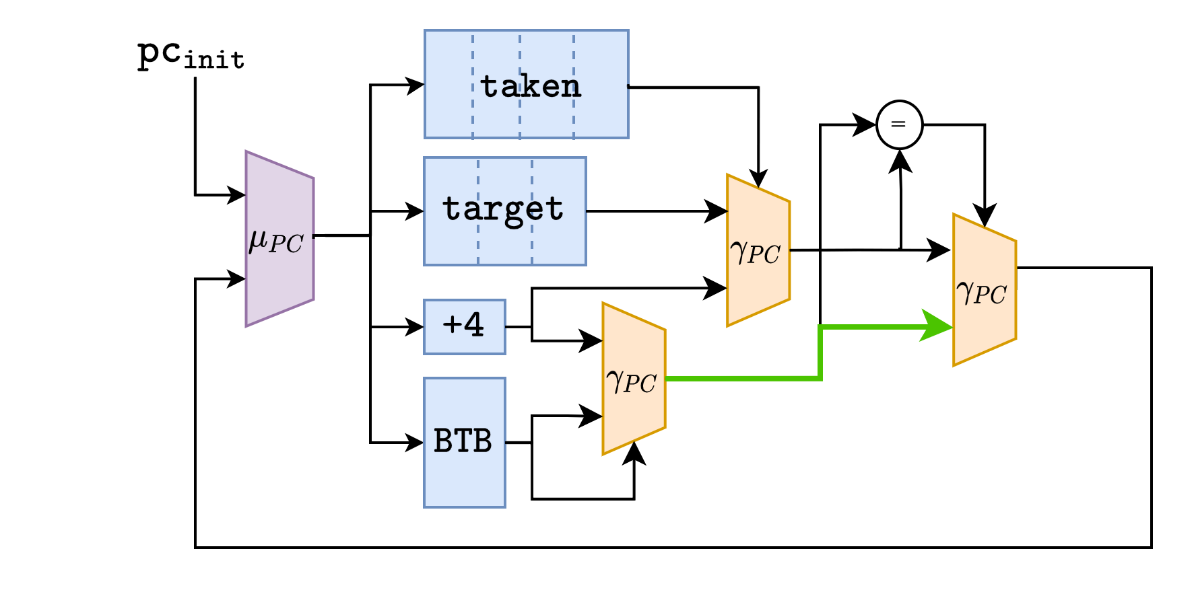
Modeling complex μarch features

Slide 47
Handling multiple speculations
Based on interaction patterns between speculations
One type of FSM per speculation pattern
Decoupled speculations
Independant speculations
Data dependant speculations
Control dependant speculations

Slide 48
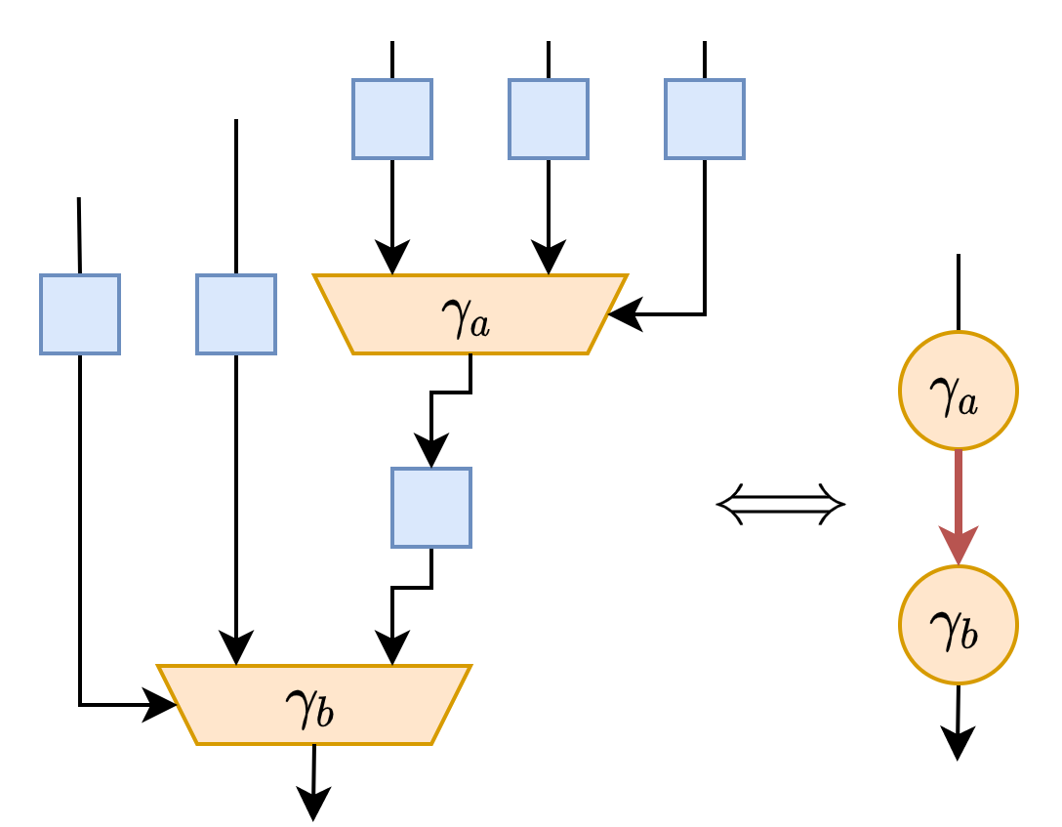
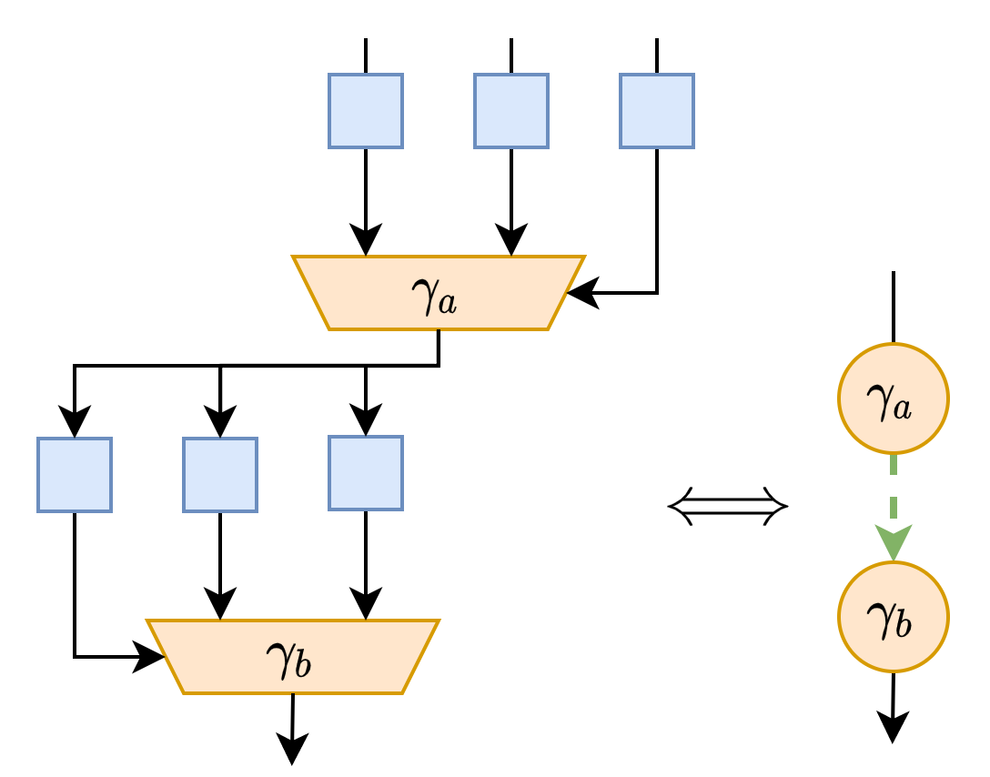
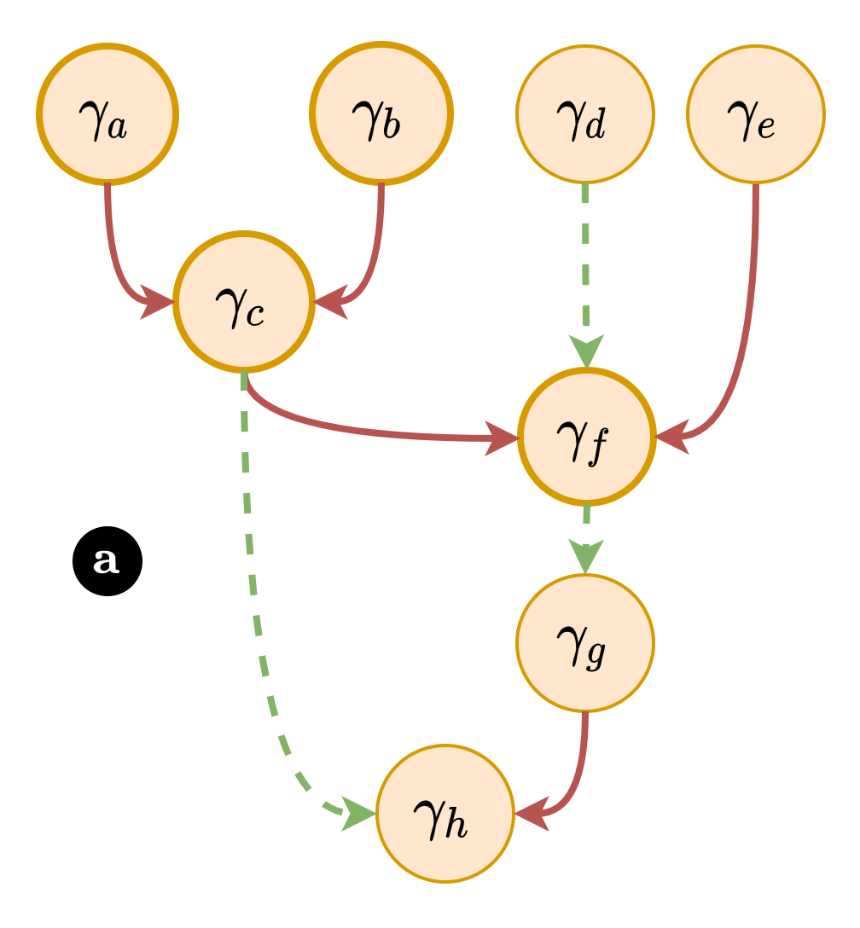
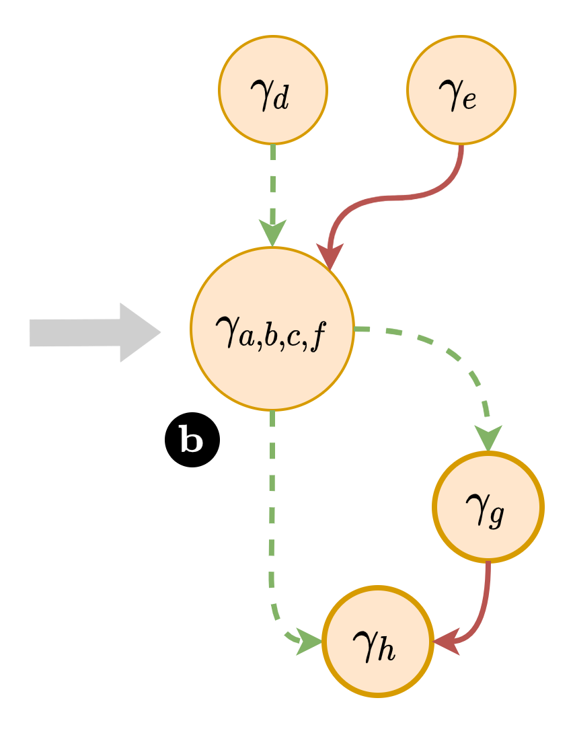
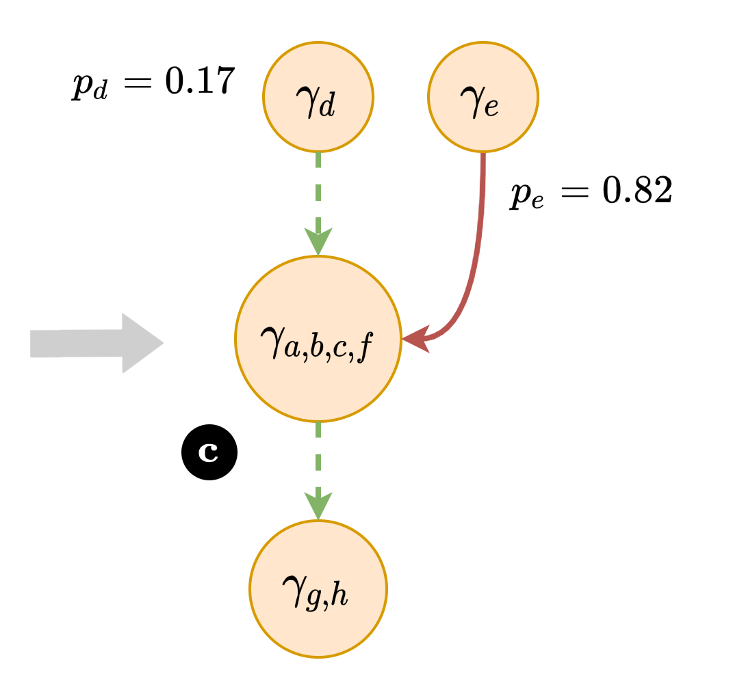
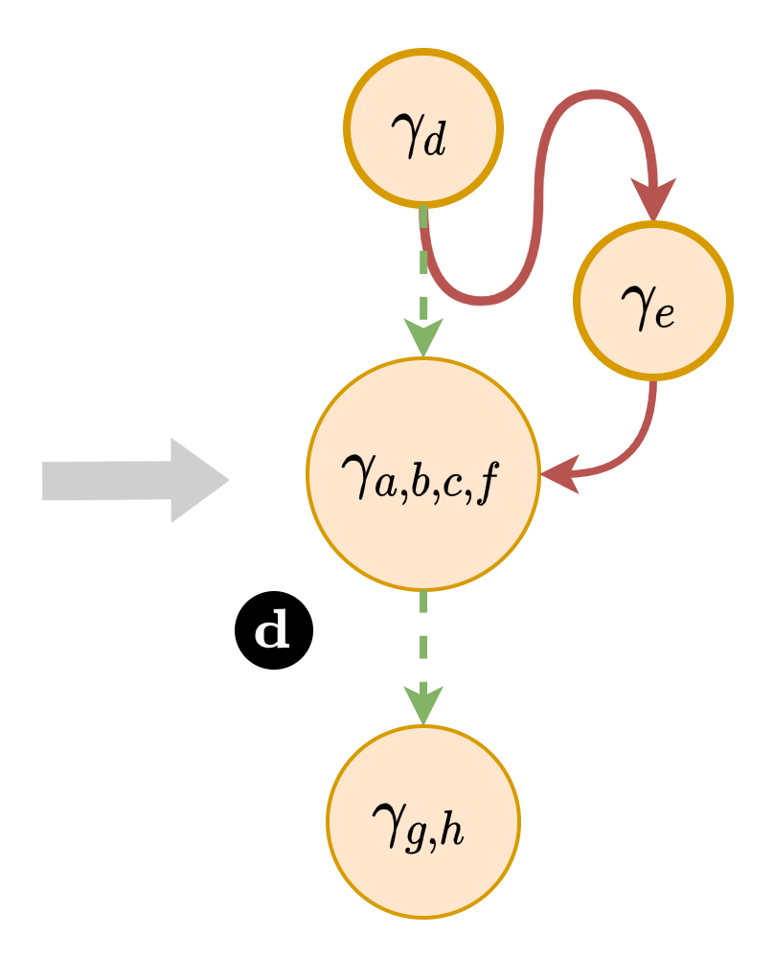
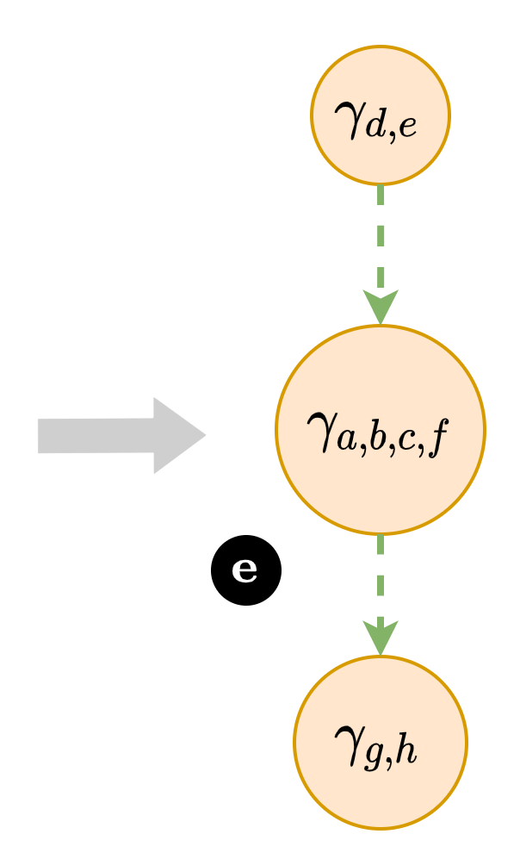
Composing FSM
The set of speculated γ nodes forms a DAG
We merge its node using a set of rewriting rules
Data domination
Control domination

Slide 49
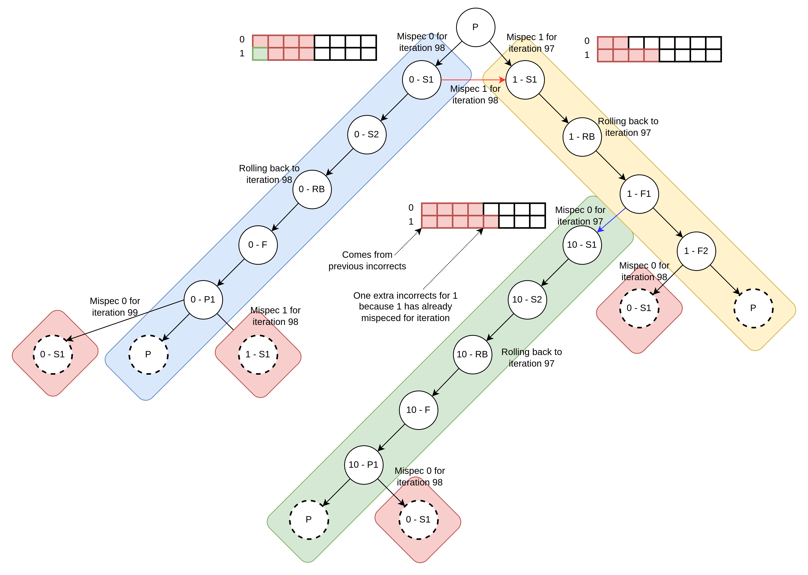
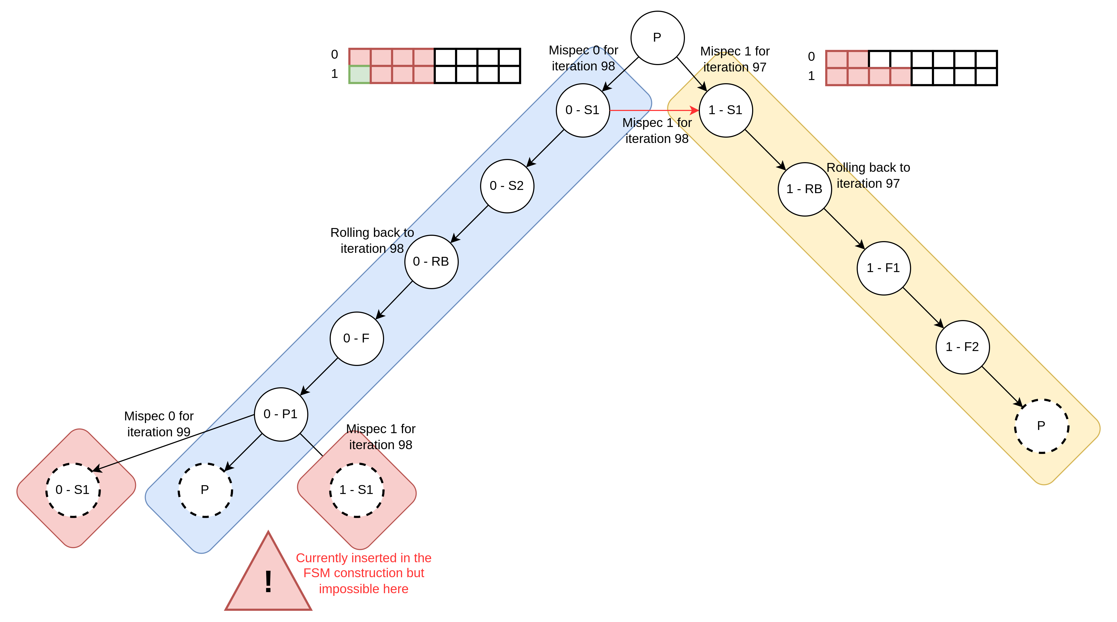
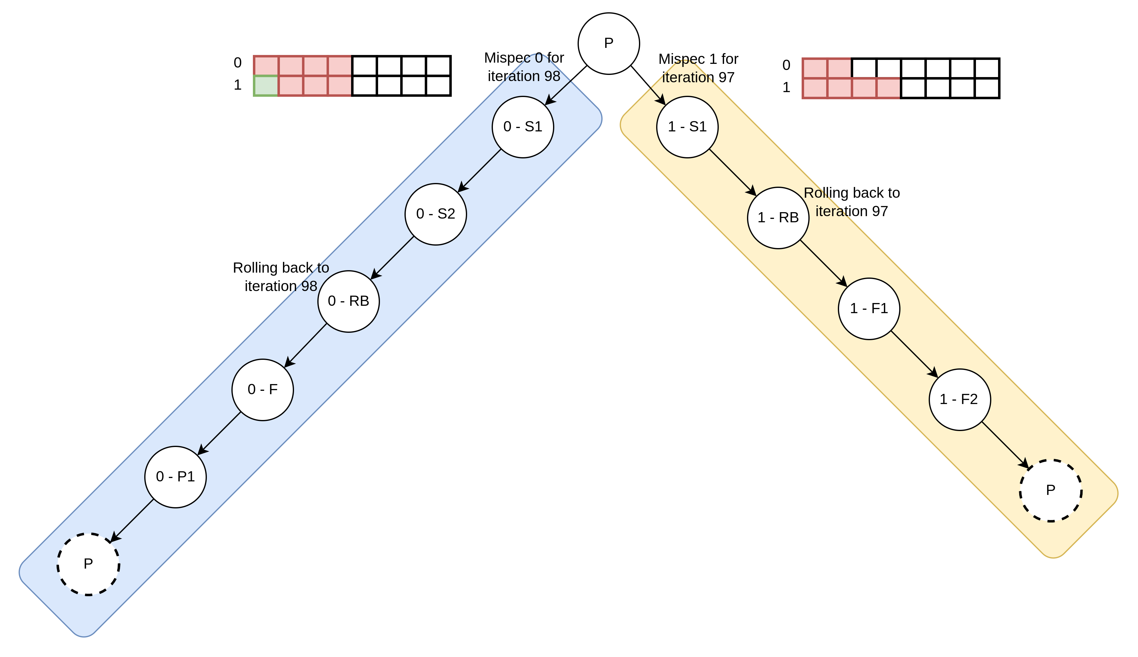
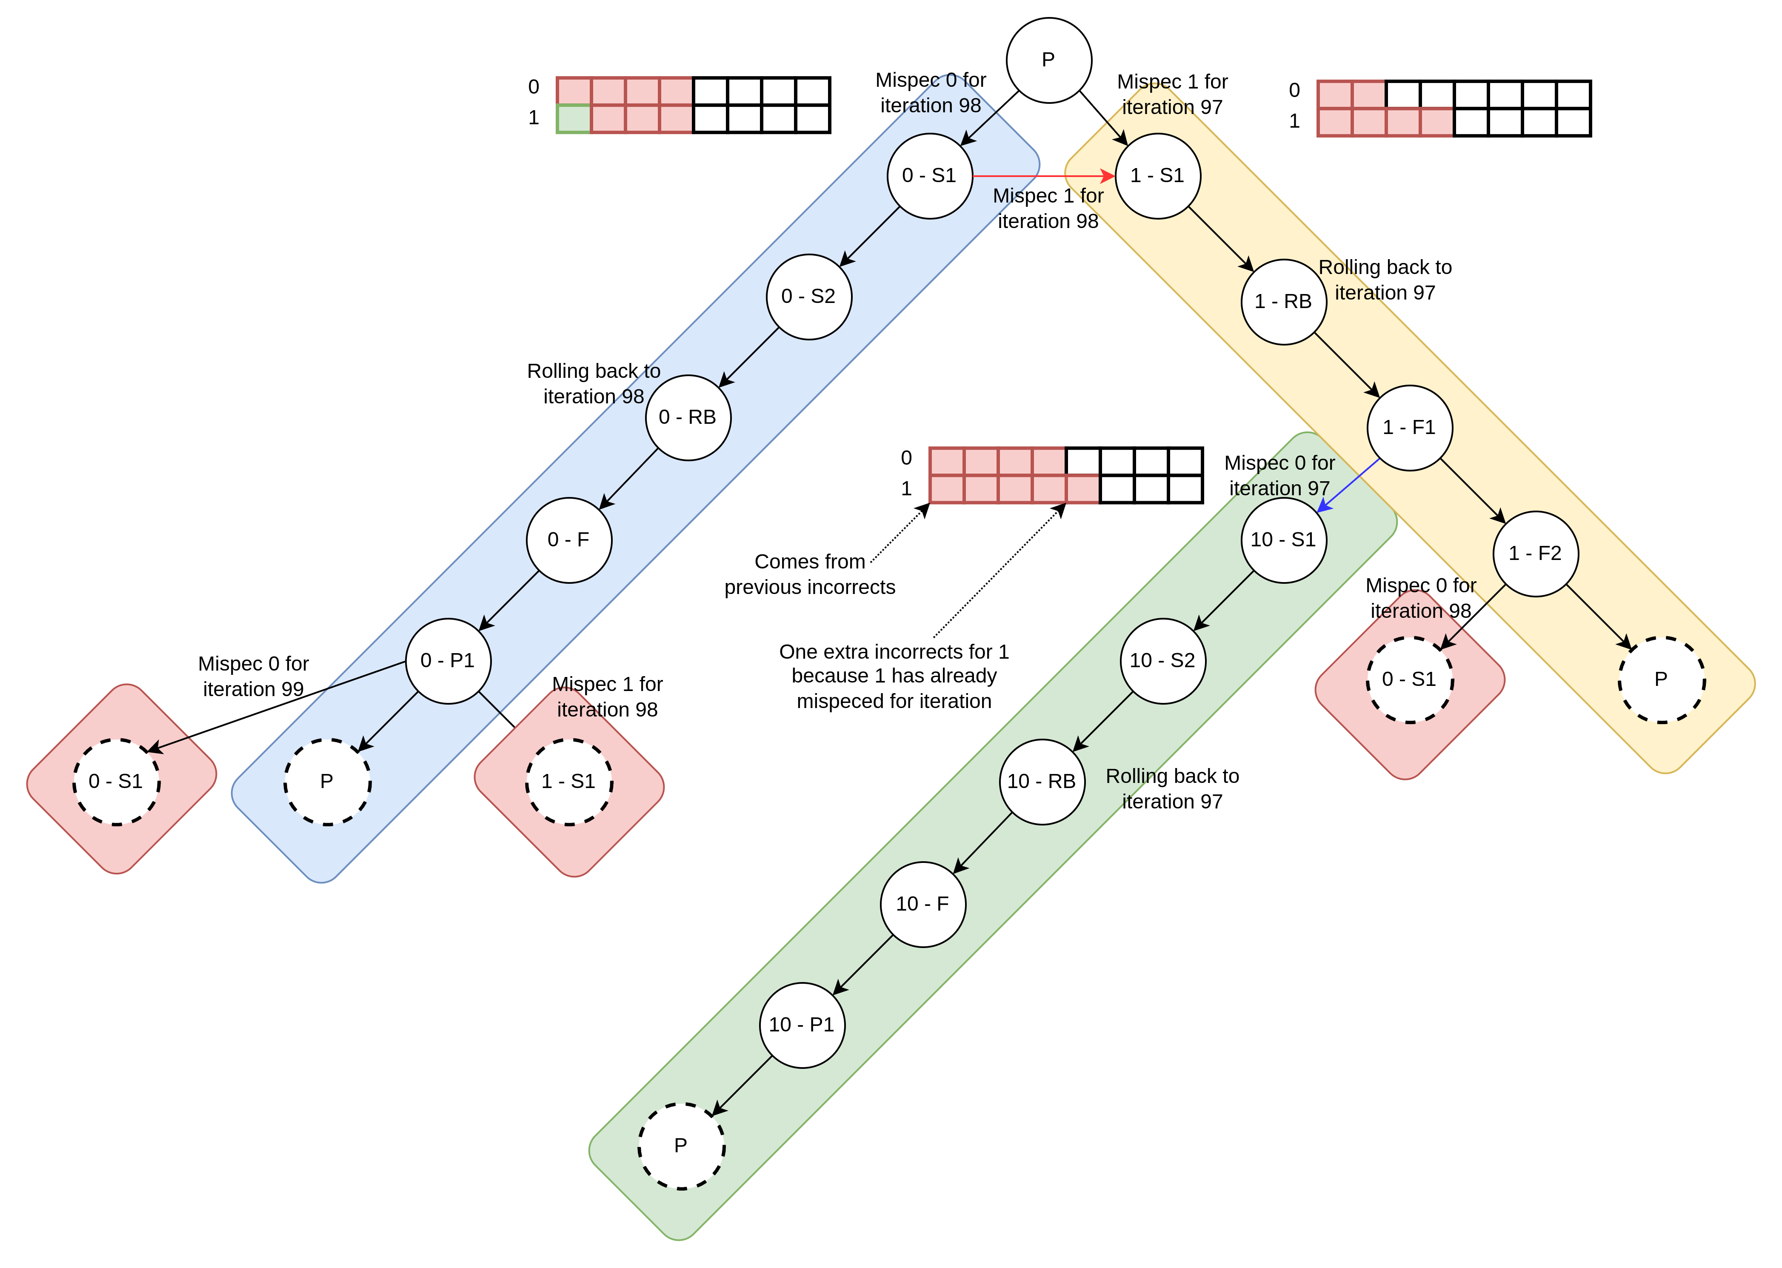
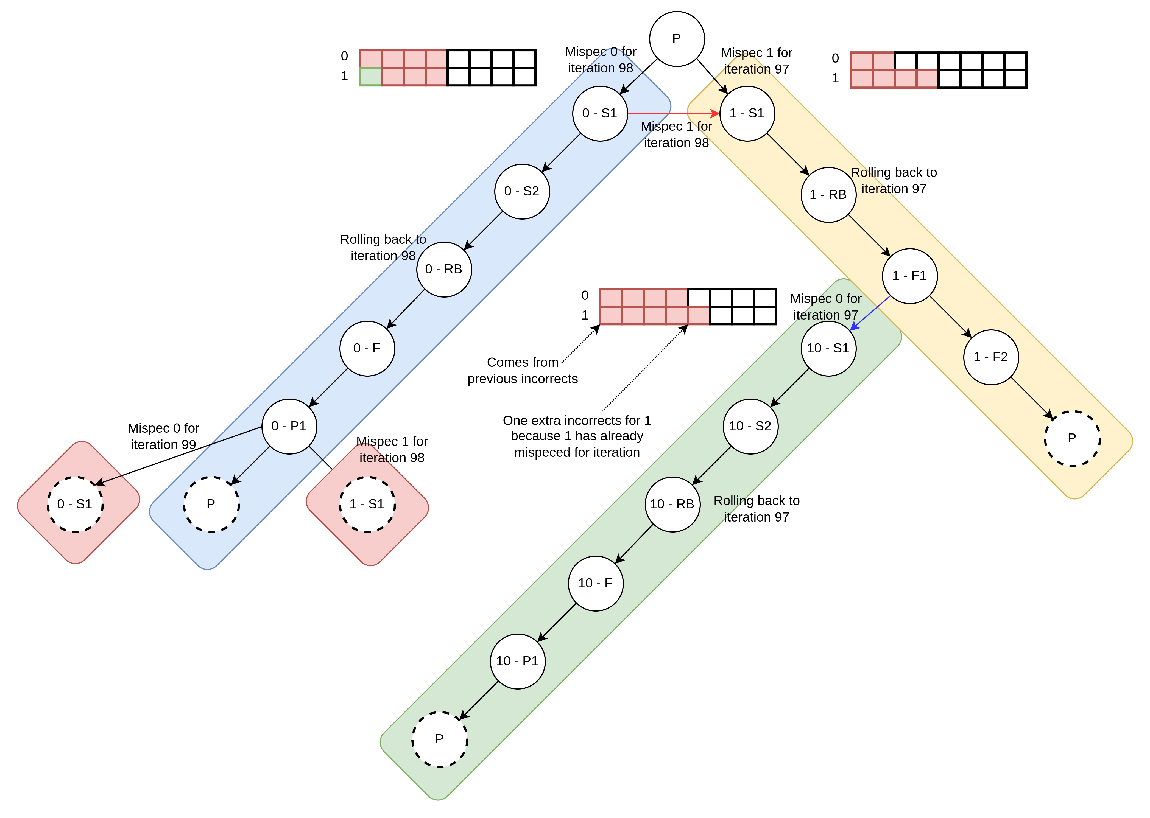
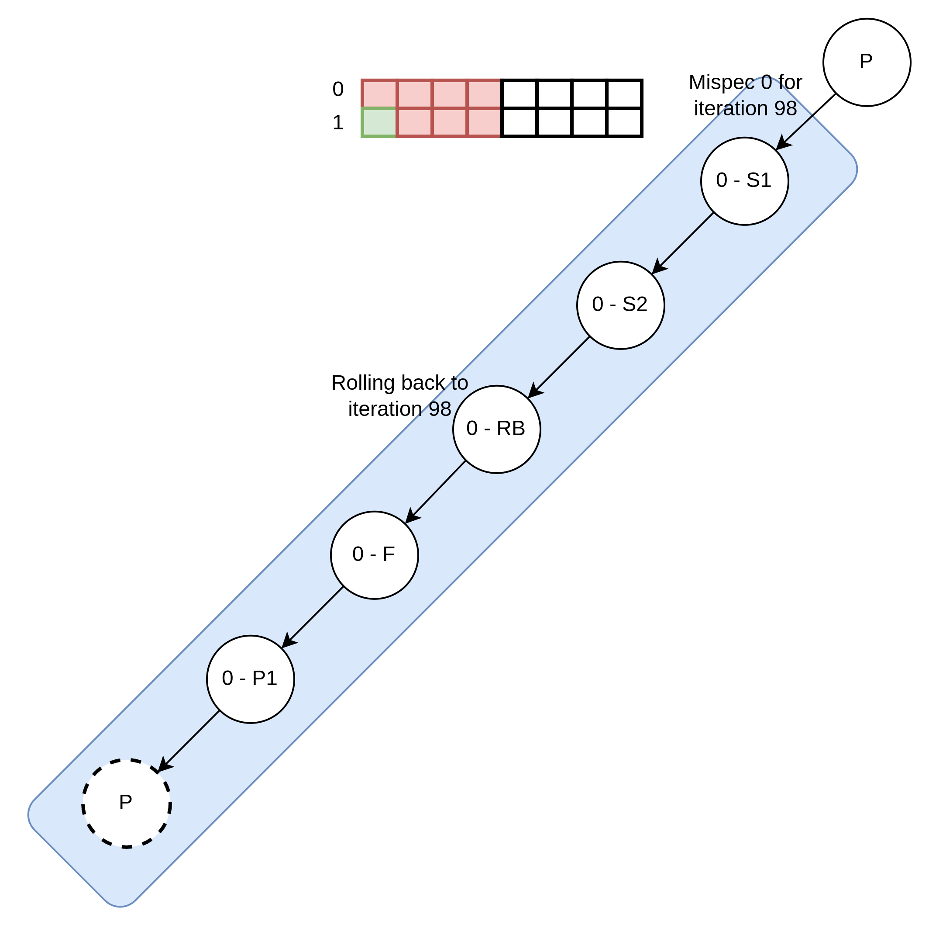
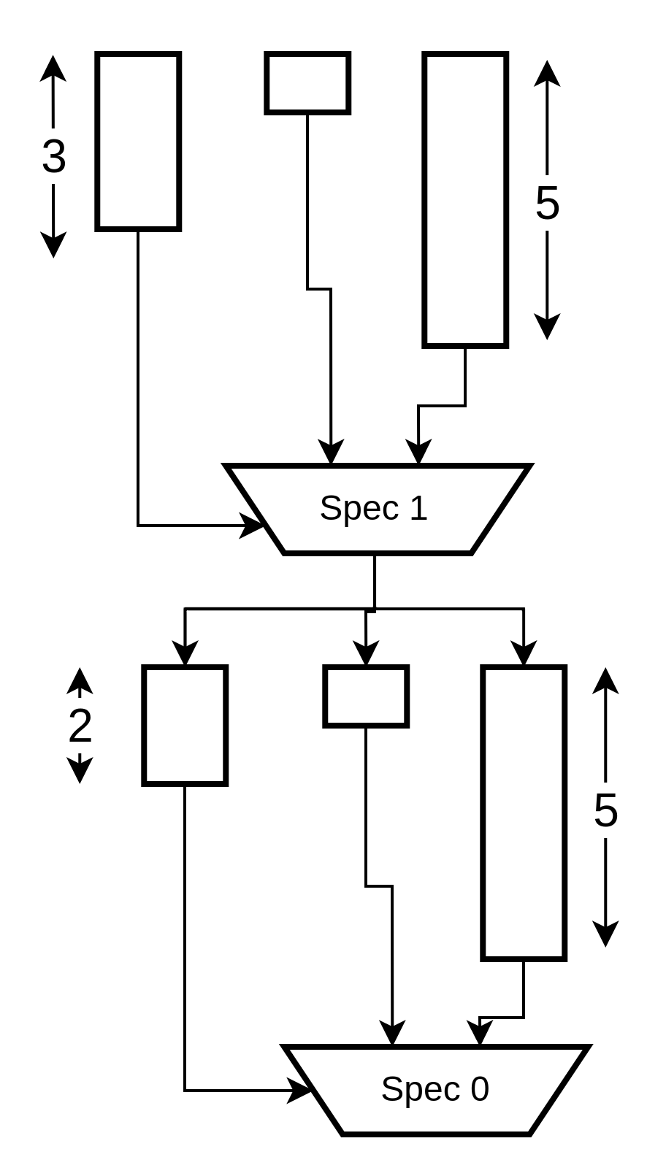

Handling multiple speculations
For a control-dominated double speculation
Retour sur un autre état qui existe déjà

Slide 50

Example – 3 deep speculation

Slide 51

IDG from mini RISC-V ISA model
62 binary gamma nodes → 4.10²⁸. configurations

Slide 52


Gamma factorization
Expose hardware reuse through factorization
Tends to increase the number of gamma nodes

Slide 53

IDG from mini RISC-V ISA model
6 gamma nodes → 2.10³. configurations

Slide 54
SLP as a source-to-source transform
Expose dependance distance in the source code
do {
#pragma hls pipeline II=1
ctrl[t] = C (s_x[t-2);
mis_x[t] = S (s_x[t-3]);
s_x[t] = F (s_x[t-1],s_y[t-1]);
s_y[t] = H (s_x[t-1],s_y[t-1]);
cs = nextState(cs,ctrl[t]);
if (cs.rollback) {
s_y[t] = s_y[t-4];
s_x[t] = mis_x[t]
}
if (cs.commit) {
x = cs.sel? s_x[t-1]:mis_x[t];
y = s_y[t-1];
}
t++;
} while(!(x && cs.commit));
datapath with explicit pipeline reuse distance
1
2 stage pipeline for function C
H
control FSM
2
S
F
C
3 stage pipeline for function S
FSM
Notes:
In this work, we perform the program transformation directly at the source level, using a source to source compiler.
The transformed source is not easy to understand, so we will review it step by step.
[NEXT]
The first step consists in introducing shadow variables s_x and s_y which we use to store the speculative versions of x and y.
The second steps aims at forcing the HLS tool to derive a pipelined datapath with specific pipeline depths. We therfore
need a way to specify the pipeline schedule depth directly in the source code. We achieve this by making the reuse distance explicit in the access patterns.
[NEXT]
For example, by using the access pattern s_x[t-2], we provide just enough slack for a two stage pipeline implementation of the function C. Similarly, the access pattern s_x[t-3] will enable a 5 stage pipeline implementation for S.
Of course this implementation is impractical as it requires infinite buffers. In practice, we use either delay lines (or circular buffers as in this example) [NEXT]
At this point, we have obtained a pipelined datapath, but we need to make sure it performs the same computations as the original code. More specifically, we have to detect and resolve mispeculations.
Step 2:
We embed the mispeculations management timing logic within a Finite State Machine which we describe in the next slide. This FSM takes as input the outcome of the current control predicate, and produces 3 output control signals.

Slide 55
SLP within a source-to-source compiler
Manage mispeculations using additionnal logic
do {
#pragma hls pipeline II=1
ctrl[t] = C (s_x[t-2);
mis_x[t] = S (s_x[t-3]);
s_x[t] = F (s_x[t-1],s_y[t-1]);
s_y[t] = H (s_x[t-1],s_y[t-1]);
cs = nextState(cs,ctrl[t]);
if (cs.rollback) {
s_y[t] = s_y[t-4];
s_x[t] = mis_x[t]
}
if (cs.commit) {
x = cs.sel? s_x[t-1]:mis_x[t];
y = s_y[t-1];
}
t++;
} while(!(x && cs.commit));
datapath with explicit pipeline reuse distance
1
RB
RB
H
control FSM
2
S
F
C
branch mispeculation management (rollback)
3
FSM
commit step
4
exit condition
Commit
5
Notes:
Step 3:
When a mispeculation occur, it is necessary to reinject the correct values from the slow path in the pipeline (in our case mis_x[t%3]), and rollback variables to a previous valid state (s_y[(t-4)%3] for variable s_y); This step occurs when the FSM asserts the cs.rollback field to true.
Step 4:
Once the speculation is known to be sucessfull, or after having recovered from a mispeculation, we can safely commit the speculative value to the actual variables x and y. This step occurs when the FSM asserts the cs.commit field to true.
Step 5:
We also make sure the loop exit condition is modified to filter out iterations where no new values are commited.

Slide 56
Running example
cnt/=0,
cnt:=cnt-1
sel=0
commit=1
rollback=1
ROLLB
FILL
cnt:=0
cnt=0
cnt=0
C₁ | C₂ | C₃ | C₄ | - | - | - | C₄ | C₅ | C₆
 | C₁ | C₂ | C₃ | - | - | - | - | C₄ | C₅
S₁ | S₂ | S₃ | S₄ | - | - | - | S₄ | S₅ | S₆
 | S₁ | S₂ | S₃ | - | - | - | - | S₄ | S₅
 |  | S₁ | S₂ | S₃ | - | - | - | - | S₄
 |  |  | S₁ | S₂ | S₃ | - | - | - | -
 |  |  |  | S₁ | S₂ | S₃ | - | - | -
STALL
ctrl,
cnt:=1
RUN
sel=1
commit=1
cnt/=0,
cnt:=cnt-1
datapath
F₁ | F₂ | F₃ | F₄ | - | - | F₃ | F₄ | F₅ | F₆
H₁ | H₂ | H₃ | H₄ | - | - | H₃ | H₄ | H₅ | H₆
_{FILL} | _{RUN} | _{RUN} | _{RUN} | _{STALL} | _{STALL} | _{ROLLB} | _{FILL} | _{RUN} | _{RUN}
FSM
rollBack
commit
x₁
y₁
x₂
y₂
x₃
y₃
commit
Notes:
To better understand how the kernel behaves we will simulate its operation on a simple example.
[Next]
To do so, we will use the control FSM whose transition diagram is depicted on the top of the slide.
To avoid confusion, we will make the difference between iterations from the original loop (which we will refer to as « iteration ») from iterations from the transformed loop, which we will call time steps.
[NEXT] [NEXT]
In this scheme the loop execution starts in the FILL state, and [NEXT] speculatively assumes the fast branch to be taken.
This enables the next loop iteration to start in the next time step.
Since the control condition is implemented as a two stage pipeline, the pipeline enters its steady state during this second time step, and the FSM then switches to the RUN state. The first speculation is then resolved. [NEXT] [NEXT] Since no mispeculaton occured, the correct values of x and y are commited from the fast path. [Next]
As for the first iteration, we again speculatively assume the fast branch is taken, and proceed to the third time step, where we resolve the second iteration control condition. [Next][Next] Here again, no mispeculation occured and we commit new values for x and y.
The situation is different at the fourth time step, as a mispeculation occured while starting the fourth loop iteration [Next]. As a result, we must discard the current computations [Next], and stall until we proceed through the five stages of the slow path. [NEXT] [NEXT] [NEXT]
Once we reach the fifth pipeline stage for function S, we switch to the rollback state, where we rollback s_y to its last valid value, [Next] and commit the output of S for x [Next]
From there, we loop back to the FILL state and reinitiate our speculative pipeline scheme.
(3 minutes)

Slide 57
Side benefits : simulation speed
Native speed cycle accurate simulation for free
  Transformed code tracks actual/true cycle count (variable t)
  Run C code and monitor values of t and true loop trip count i
Makes Design Space Exploration easier
  Enables early exploration of speculation scenarios
do {
…
if (cs.commit) {
i++;
…
}
t++;
} while(!(x && cs.commit));
Original loop counter
Speculative loop counter
Notes:
[1’30]
In addition to the performance improvements offered by speculation, which we will discuss later, implementing the transformation at the program level has several other benefits.
First, we can perform early, cycle accurate performance estimate at native speed by directly running the transformed program.
[Next]
This is because the transfomed C code captures the speculation timing penalties through the t variable in the code.
Thanks to this, Desigh Space Exploration is greatly simplified, and it is possible to quickly explore different speculation strategies by choosing more or less aggressive speculation depth, this later parameter being a design constant.

