Slide 1
Introduction to the Finite Element Toolbox
Knut Andreas Meyer
Institute of Applied Mechanics
TU Braunschweig
Le Groupe Calcul, 2024-05-31

Slide 2
Outline
What is the Julia Programming Language?
History and users of Ferrite.jl
What is Ferrite and what does it provide?
The FEM Puzzle Pieces
Walkthrough: Solving the heat equation
Changes to solve linear elasticity
Multiple domains and fields
More examples of Ferrite use-cases
Ongoing and future work
Concluding remarks and questions

Slide 3
What is Julia?
Open Source (MIT License)
A young language
First public in 2012
Release 1.0 in 2018
Currently 1.10
“Easy as python”
High-level dynamic programing language
“Fast as C”
Just-in-time compilation

Slide 4
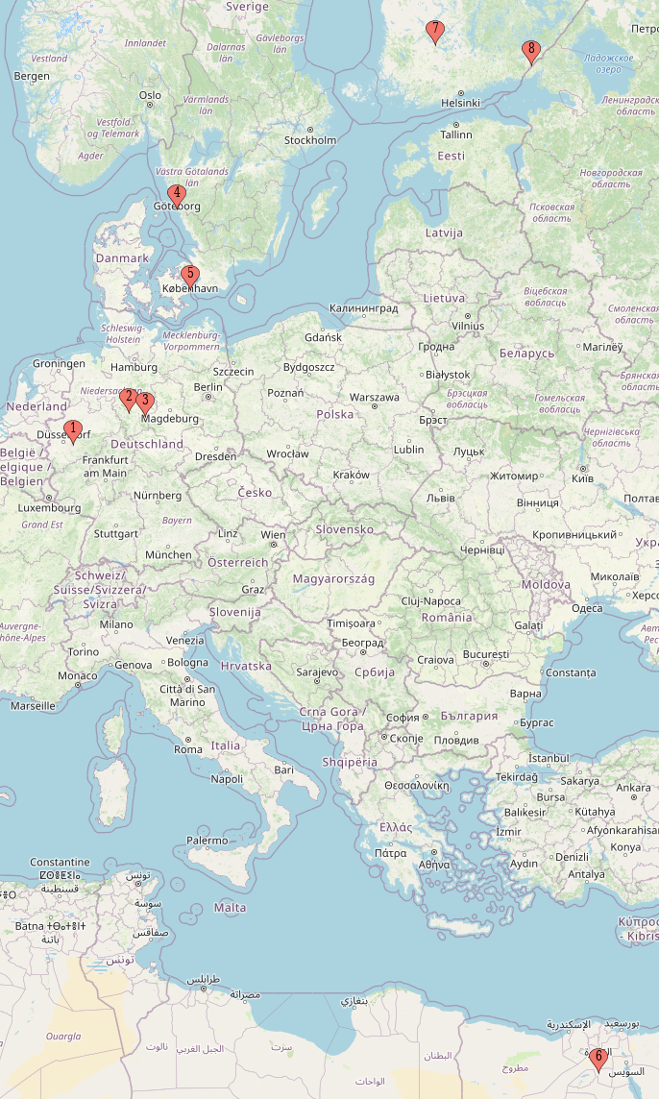
History and users of Ferrite.jl
Kristoffer Carlsson & Fredrik Ekre, Chalmers (2016)
A toolbox providing FE building blocks: Inspired by Deal.ii
Adoption
30 different contributors
317 stars / 112 members in Slack
FerriteCon
2022: Braunschweig, Germany
2023: Bochum, Germany
2024: Gothenburg, Sweden (September 16th)
Version 1.0 will be released soon

Slide 5
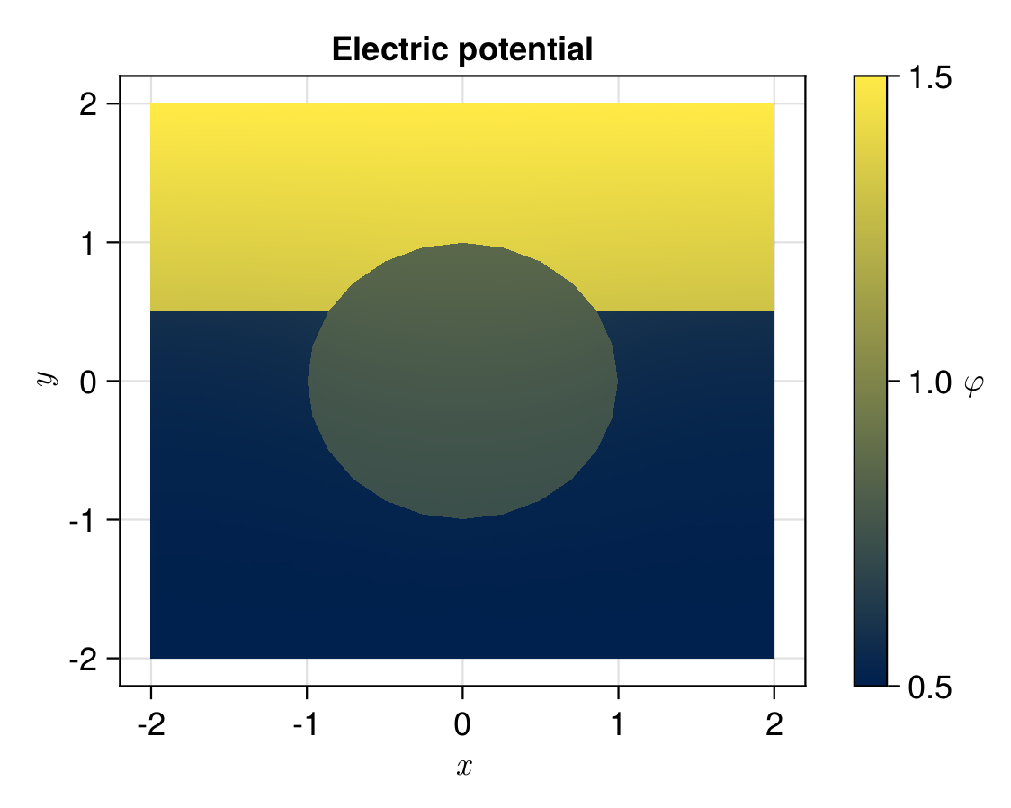
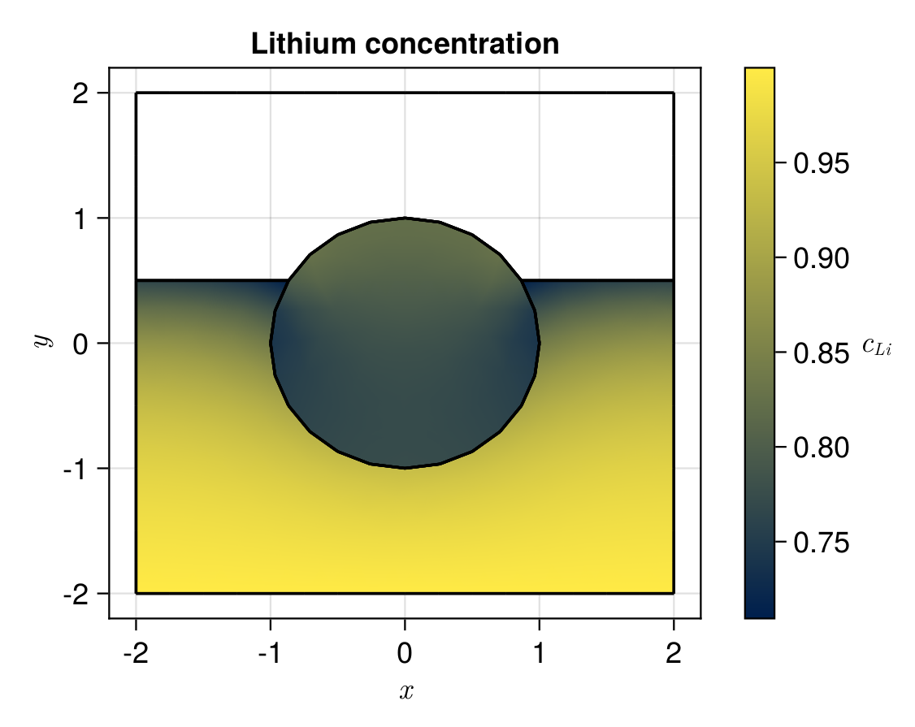
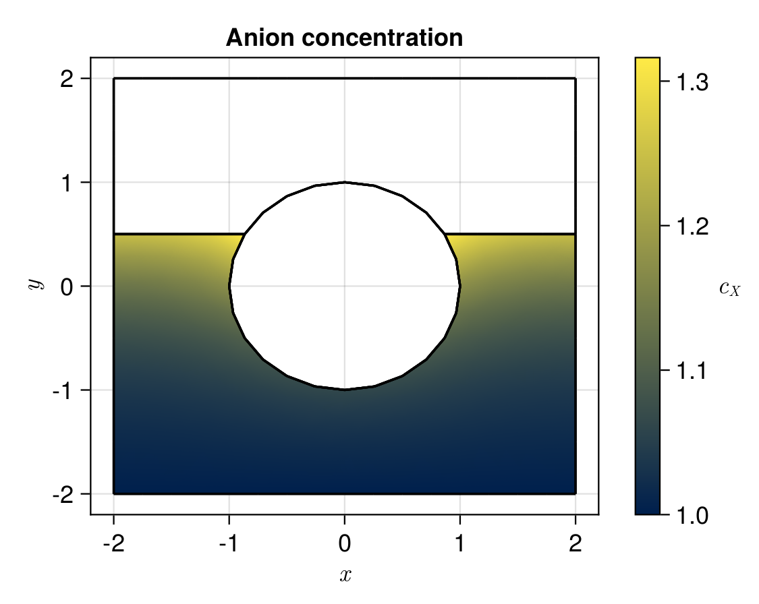
Homogenization of Structural Batteries
David Rollin: Institute of Applied Mechanics, TU Braunschweig
Modeling interfacial behavior in electroactive materials
D. R. Rollin, F. Larsson, K. Runesson, and R. Jänicke, “Upscaling of chemo-mechanical properties of battery electrode material,” Int. J. Solids Struct., vol. 281, no. February, p. 112405, 2023,

Slide 6
Cardiac Multiphysics
Dennis Ogiermann: Chair of Continuum Mechanics, Ruhr-Universität Bochum
Code: github.com/termi-official/Thunderbolt.jl
D. Ogiermann, D. Balzani, and L. E. Perotti, “An Extended Generalized Hill Model for Cardiac Tissue: Comparison with Different Approaches Based on Experimental Data,” in Functional Imaging and Modeling of the Heart, 2023, pp. 555–564.

Slide 7
FEM Puzzle Pieces: What does Ferrite provide?
Geometry
Mesh
DoF Distribution
Different fields
Function interpolations
Assembly
Cell contributions
Boundary contributions
Constraints
Linear solver
Post-processing
Secondary quantities
Visualization
Simple builtin mesh generator
Gmsh interface package FerriteGmsh.jl
Abaqus input file parser FerriteMeshParser.jl
Nonlinear iterations
Time stepping/integration
Builtin VTK (ParaView) export
FerriteViz.jl Julia (Makie) plotting library for Ferrite.jl

Slide 8
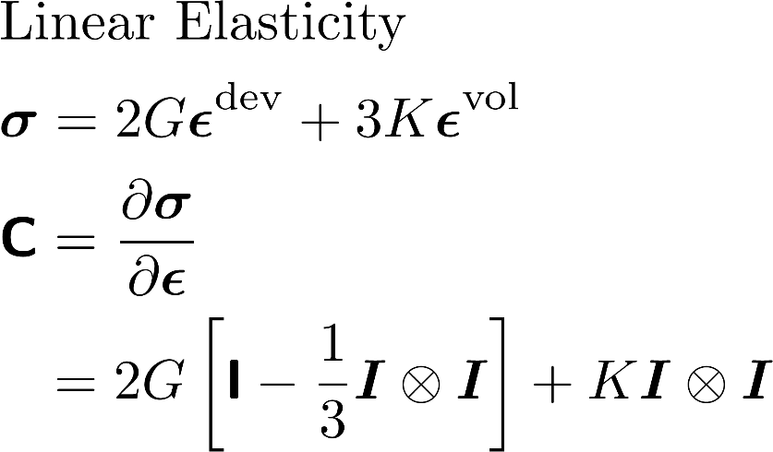
Tensors.jl
using Tensors
calculate_stress(ϵ, G, K) = 2G*dev(ϵ) + 3K*vol(ϵ)
function calculate_stiffness(G, K)
I2 = one(SymmetricTensor{2,3}) # 2nd order identity
I4 = one(SymmetricTensor{4,3}) # 4th order identity
return 2G*(I4 - I2 ⊗ I2 / 3) + K * I2 ⊗ I2
end
G = 80.e3; K = 155.e3 ϵ = rand(SymmetricTensor{2,3}) # Random 2nd order tensor
σ = calculate_stress(ϵ, G, K) C = calculate_stiffness(G, K)
# Automatic Differentiation (using ForwardDiff.Dual) gradient(e -> calculate_stress(e, G, K), ϵ) ≈ C

Slide 9
DoF Distribution
grid = generate_grid(Triangle, (20, 20));
ip = Lagrange{RefTriangle, 1}()
ip2 = Lagrange{RefTriangle, 2}()
dh = DofHandler(grid)
add!(dh, :u, ip)
add!(dh, :v, ip2)
add!(dh, :w, ip^2)
close!(dh);
w4
w3
n2
u2
v2
v5
v4
w6
w2
w5
w1
n3
n1
u3
u1
v3
v6
v1

Slide 10
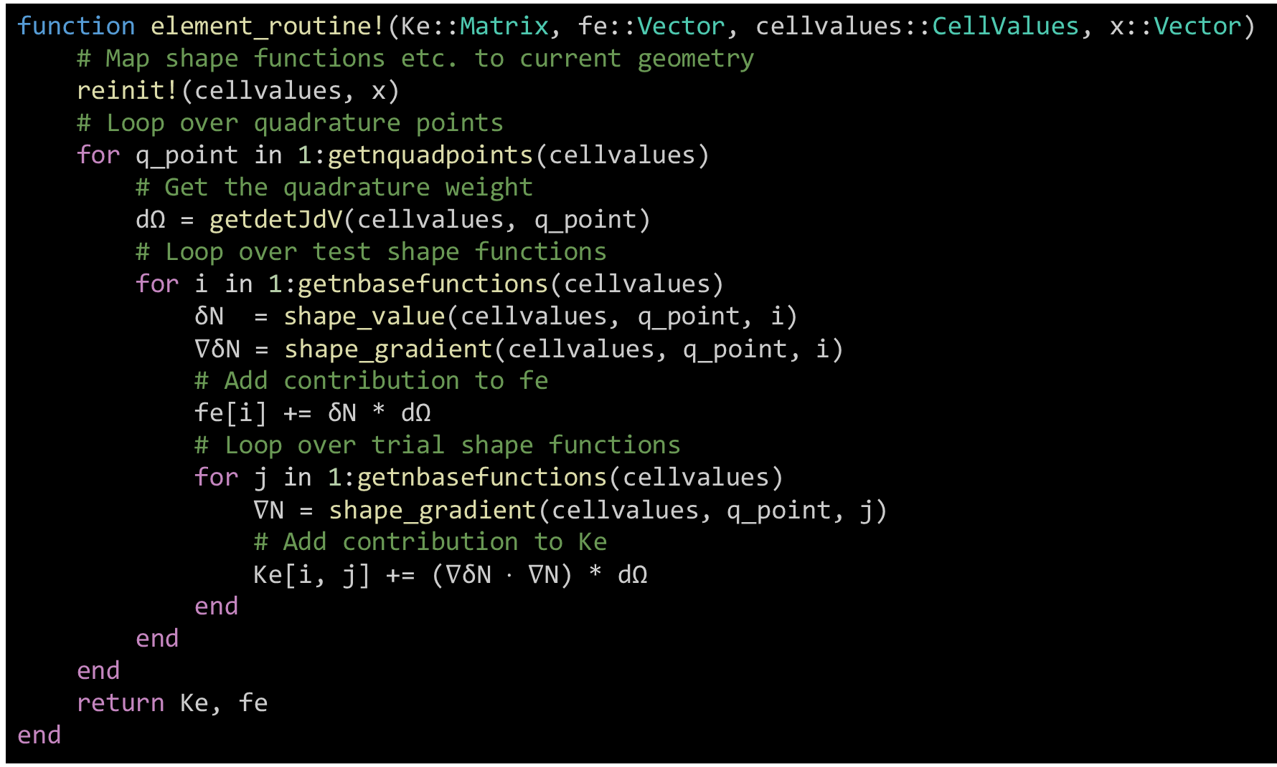
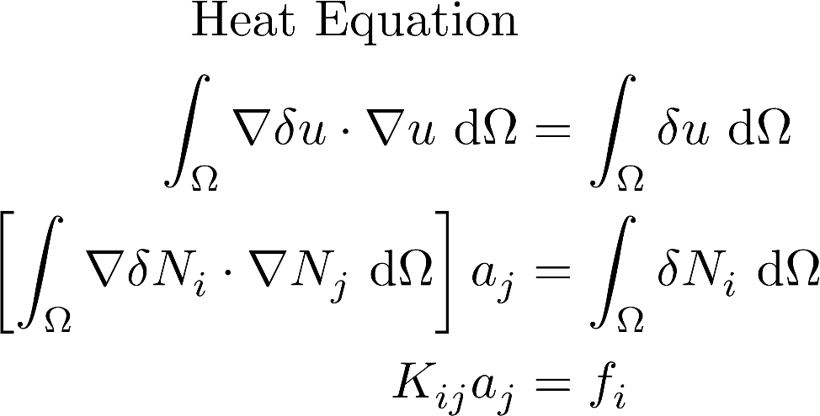
Assembly: Calculate cell contribution
Setup
ip = Lagrange{RefTriangle, 1}() # Defined before
ip_geo = ip # Geometric interpolation
qr = QuadratureRule{RefTriangle}(2) # Numerical integration
cellvalues = CellValues(qr, ip, ip_geo) # “Shape function object”
Element routine

Slide 11
function element_routine!(Ke::Matrix, fe::Vector, cellvalues::CellValues, cellcoords::Vector)
# Map shape function gradients etc. to current geometry
reinit!(cellvalues, cellcoords)
# Loop over quadrature points
for q_point in 1:getnquadpoints(cellvalues)
# Get the quadrature weight
dΩ = getdetJdV(cellvalues, q_point)
# Loop over test shape functions
for i in 1:getnbasefunctions(cellvalues)
δNᵢ = shape_value(cellvalues, q_point, i)
∇δNᵢ = shape_gradient(cellvalues, q_point, i)
# Add heat source to fe
fe[i] += δNᵢ * dΩ
# Loop over trial shape functions
for j in 1:getnbasefunctions(cellvalues)
∇Nⱼ = shape_gradient(cellvalues, q_point, j)
# Add contribution to Ke
Ke[i, j] += (∇δNᵢ ⋅ ∇Nⱼ) * dΩ
end
end
end
return Ke, fe
end

Slide 12
function element_routine!(Ke::Matrix, fe::Vector, cellvalues::CellValues, cellcoords::Vector)
# Map shape function gradients etc. to current geometry
reinit!(cellvalues, cellcoords)
# Loop over quadrature points
for q_point in 1:getnquadpoints(cellvalues)
# Get the quadrature weight
dΩ = getdetJdV(cellvalues, q_point)
# Loop over test shape functions
for i in 1:getnbasefunctions(cellvalues)
δNᵢ = shape_value(cellvalues, q_point, i)
∇δNᵢ = shape_gradient(cellvalues, q_point, i)
# Add heat source to fe
fe[i] += δNᵢ * dΩ
# Loop over trial shape functions
for j in 1:getnbasefunctions(cellvalues)
∇Nⱼ = shape_gradient(cellvalues, q_point, j)
# Add contribution to Ke
Ke[i, j] += (∇δNᵢ ⋅ ∇Nⱼ) * dΩ
end
end
end
return Ke, fe
end

Slide 13
Assembly: Assemble cell contribution
function assemble_global(cellvalues::CellValues, dh::DofHandler)
# Allocate global stiffness matrix, K, and force vector, f
K = create_sparsity_pattern(dh)
f = zeros(ndofs(dh))
# Allocate the element stiffness matrix and element force vector
n_basefuncs = getnbasefunctions(cellvalues)
Ke = zeros(n_basefuncs, n_basefuncs)
fe = zeros(n_basefuncs)
assembler = start_assemble(K, f) # Create an assembler
for cell in CellIterator(dh) # Loop over all cells
fill!(Ke, 0); fill!(fe, 0) # Reset Ke and fe
# Compute element contribution
element_routine!(Ke, fe, cellvalues, getcoordinates(cell))
# Assemble local, Ke and fe, into global, K and f
assemble!(assembler, celldofs(cell), Ke, fe)
end
return K, f
end

Slide 14
Constraints: Dirichlet Boundary Conditions
grid, dh, cellvalues = setup() # Pseudocode, see earlier slides
K, f = assemble_global(cellvalues, dh)
ch = ConstraintHandler(dh);
∂Ω = union(getfacetset(grid, "left"), getfacetset(grid, "right"),
getfacetset(grid, "top"), getfacetset(grid, "bottom"));
add!(ch, Dirichlet(:u, ∂Ω, (x, t) -> 0))
close!(ch)
apply!(K, f, ch) # Modify K and f to fulfill constraints

Slide 15
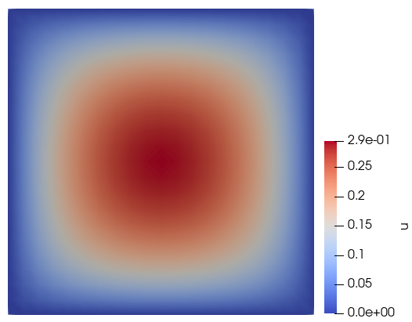
Putting it together: Stationary Heat Equation
https://ferrite-fem.github.io/Ferrite.jl/dev/tutorials/heat_equation/
u = K \ f # Solve linear system
# Export solution
VTKFile("heat_equation", dh) do vtk
write_solution(vtk, dh, u)
end

Slide 16
Change to linear elasticity
# Setup
ip = Lagrange{RefTriangle, 1}() # Function interpolation
ip_geo = ip # Geometric interpolation
qr = QuadratureRule{RefTriangle}(2) # Numerical integration
# cellvalues = CellValues(qr, ip, ip_geo)
cellvalues = CellValues(qr, ip^2, ip_geo)

Slide 17
Change to linear elasticity
function element_routine!(Ke::Matrix, fe::Vector, cv::CellValues, cellcoords::Vector)
reinit!(cv, cellcoords) # Map cellvalues to cell geometry
for q_point in 1:getnquadpoints(cv) # Loop over quadrature points
dΩ = getdetJdV(cv, q_point) # Get the quadrature weight
C = calculate_stiffness(1.0, 2.0) # Stiffness from before
for i in 1:getnbasefunctions(cv) # Loop over test shape functions
δNᵢ = shape_value(cv, q_point, i)
∇δNᵢ = shape_gradient(cv, q_point, i)
fe[i] += δNᵢ * dΩ # Add heat source to fe
fe[i] += (δNᵢ ⋅ Vec((0.0, -1.0)))* dΩ ⋅ # Add body force to fe
for j in 1:getnbasefunctions(cv) # Loop over trial shape functions
∇Nⱼ = shape_gradient(cv, q_point, j)
Ke[i, j] += (∇δNᵢ ⋅ ∇Nⱼ) * dΩ # Add contribution to Ke
Ke[i, j] += (∇δNᵢ ⊡ C ⊡ ∇Nⱼ) * dΩ # Add contribution to Ke
end
end
end
return Ke, fe
end
# fe[i] += δNᵢ * dΩ
# Ke[i, j] += (∇δNᵢ ⋅ ∇Nⱼ) * dΩ

Slide 18
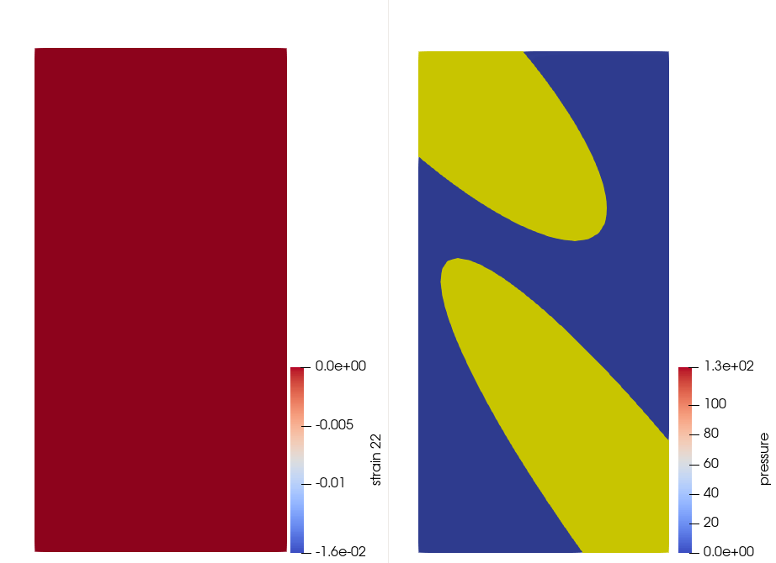
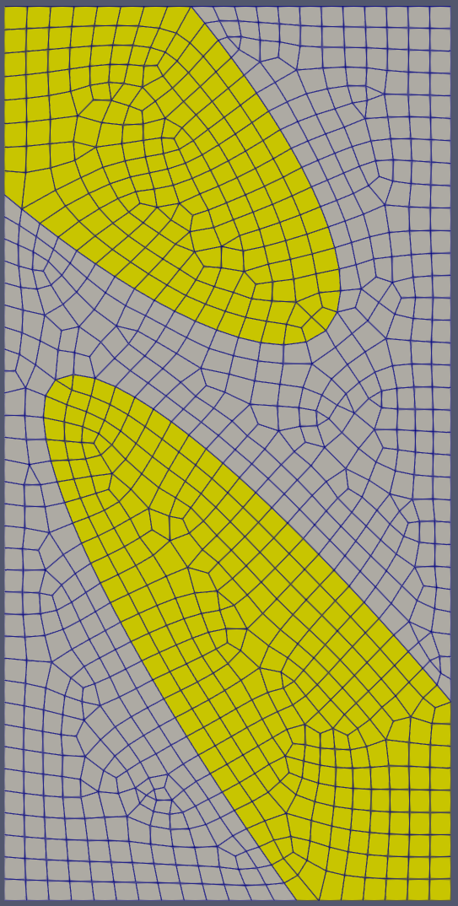
More advanced cases: Porous media, grid with mixed element shapes
Solid aggregates
(Linear elasticity)
Porous matrix
(Linear poro-elasticity)

Slide 19
More advanced cases: Porous media, mixed grid
Solid aggregates
(Linear elasticity)
Displacement (u)
Quads and triangles
Porous matrix
(Linear poro-elasticity)
Pressure (p) and displacement (u)
Quads and triangles
# Define interpolations
# Quadratic displacement, quad elements
ipu_quad = Lagrange{RefQuadrilateral, 2}()^2
# Quadratic displacement, triangular elements
ipu_tri = Lagrange{RefTriangle, 2}()^2
# Linear pressure, quad elements
ipp_quad = Lagrange{RefQuadrilateral, 1}()
# Linear pressure, triangular elements
ipp_tri = Lagrange{RefTriangle, 1}()
# Quadrature rules
qr_quad = QuadratureRule{RefQuadrilateral}(2) # 2x2 quadrature
qr_tri = QuadratureRule{RefTriangle}(2) # 3 quadrature points

Slide 20
More advanced cases: Porous media, mixed grid
Solid aggregates
(Linear elasticity)
Displacement (u)
Quads and triangles
Porous matrix
(Linear poro-elasticity)
Pressure (p) and displacement (u)
Quads and triangles
# Setup the DofHandler
dh = DofHandler(grid)
# Solid quads
sdh_solid_quad = SubDofHandler(dh, getcellset(grid,"solid4"))
add!(sdh_solid_quad, :u, ipu_quad)
# Solid triangles
sdh_solid_tri = SubDofHandler(dh, getcellset(grid,"solid3"))
add!(sdh_solid_tri, :u, ipu_tri)
# Porous quads
sdh_porous_quad = SubDofHandler(dh, getcellset(grid, "porous4"))
add!(sdh_porous_quad, :u, ipu_quad)
add!(sdh_porous_quad, :p, ipp_quad)
# Porous triangles
sdh_porous_tri = SubDofHandler(dh, getcellset(grid, "porous3"))
add!(sdh_porous_tri, :u, ipu_tri)
add!(sdh_porous_tri, :p, ipp_tri)
close!(dh)

Slide 21
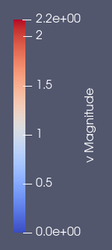
Navier-Stokes

Slide 22
3 research examples

Slide 23
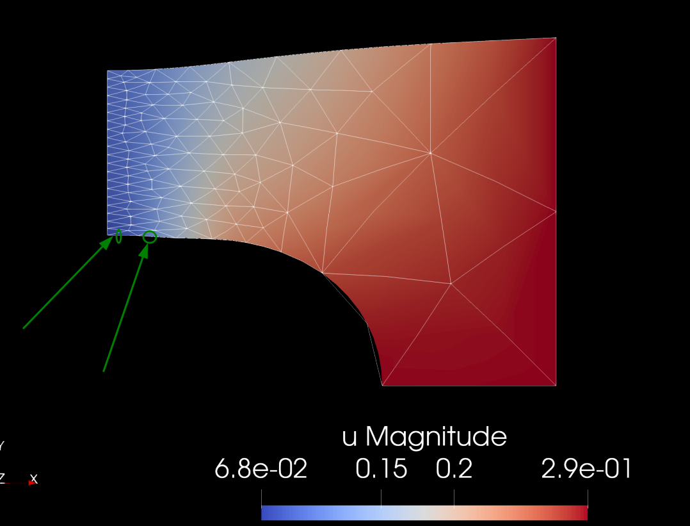
Convexification of Finite Strain Damage Models
Maximilian Köhler: Chair of Continuum Mechanics, Ruhr-Universität Bochum
D. Balzani, M. Köhler, T. Neumeier, M. A. Peter, and D. Peterseim, “Multidimensional rank-one convexification of incremental damage models at finite strains,” Comput. Mech., 2023

Slide 24
Oxygen-assisted Grain Boundary Fracture
Kim Louisa Auth: Division of Material and Computational Mechanics, Chalmers, Sweden
K. L. Auth, J. Brouzoulis, and M. Ekh, “A fully coupled chemo-mechanical cohesive zone model for oxygen embrittlement of nickel-based superalloys,” J. Mech. Phys. Solids, vol. 164, p. 104880, Jul. 2022

Slide 25
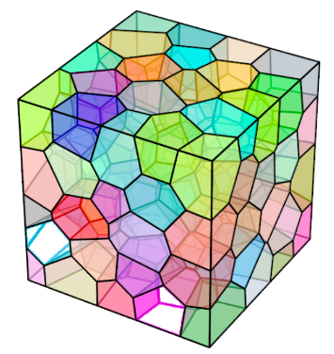
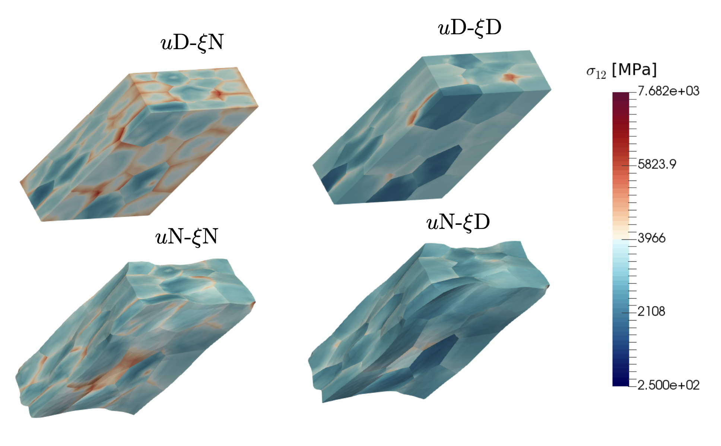
Gradient Crystal Plasticity
Kristoffer Carlsson: Division of Material and Computational Mechanics, Chalmers, Sweden
K. Carlsson, F. Larsson, and K. Runesson, “Bounds on the effective response for gradient crystal inelasticity based on homogenization and virtual testing,” Int. J. Numer. Methods Eng., vol. 119, no. 4, pp. 281–304, 2019

Slide 26
Recent and ongoing work
Discontinuous Lagrange: Abdulaziz Hamid, (Google Summer of Code / RUB)
IGA and Immersed Methods: Elias Börjesson (Chalmers)
Interface Elements: David Rollin (TU BS) and Kim Louisa Auth (Chalmers)
Mesh Adaptivity: Maximilian Köhler (RUB)
Distributed Assembly: Dennis Ogiermann (RUB)
Hdiv and Hcurl Interpolations: Knut Andreas Meyer (TU BS)
Flexible sparsity pattern: Fredrik Ekre (JuliaHub)
FerriteCon2023: https://ferrite-fem.github.io/FerriteCon/
Recorded talks: https://www.youtube.com/playlist?list=PLP8iPy9hna6RTilqYSvKzfTVh291rwo2l

Slide 27
FerriteAssembly.jl
using Ferrite, FerriteAssembly
import FerriteAssembly.ExampleElements as EE
grid = generate_grid(Triangle, (20, 20))
ip = Lagrange{RefTriangle, 1}()
dh = DofHandler(grid)
add!(dh, :u, ip)
close!(dh)
qr = QuadratureRule{RefTriangle}(2)
cellvalues = CellValues(qr, ip, ip)
# Material behavior material = EE.StationaryFourier(1.0)
ds = DomainSpec(dh, material, cellvalues)
db = setup_domainbuffer(ds)
K = create_sparsity_pattern(dh)
f = zeros(ndofs(dh))
a = zeros(ndofs(dh))
work!(start_assemble(K, f), db; a)
# Source term
lh = LoadHandler(dh)
add!(lh, BodyLoad(:u, 2, Returns(1.0)))
apply!(f, lh, 0.0)
# Dirichlet boundary conditions
ch = ConstraintHandler(dh)
∂Ω = union((getfacetset(grid, k) for k in
("left", "right", "top", "bottom"))...)
add!(ch, Dirichlet(:u, ∂Ω, Returns(0.0)))
close!(ch)
apply!(K, f, ch) # Modify K and f to fulfill BC
u = K \ f; # Solve linear system
# Export solution
VTKFile("heat_equation_fa", dh) do vtk
write_solution(vtk, dh, u)
end
db = setup_domainbuffer(ds; threading=true)

Slide 28
IGA of delamination in composites
Elias Börjesson: Division of Material and Computational Mechanics, Chalmers, Sweden
IGA required for higher accuracy of
out-of-plane stress for shell elements
Code: https://github.com/lijas/IGA.jl
E. Börjesson, J. J. C. Remmers, and M. Fagerström, “An adaptive isogeometric shell element for the prediction of initiation and growth of multiple delaminations in curved composite structures,” Comput. Struct., vol. 260, 2022

Slide 29
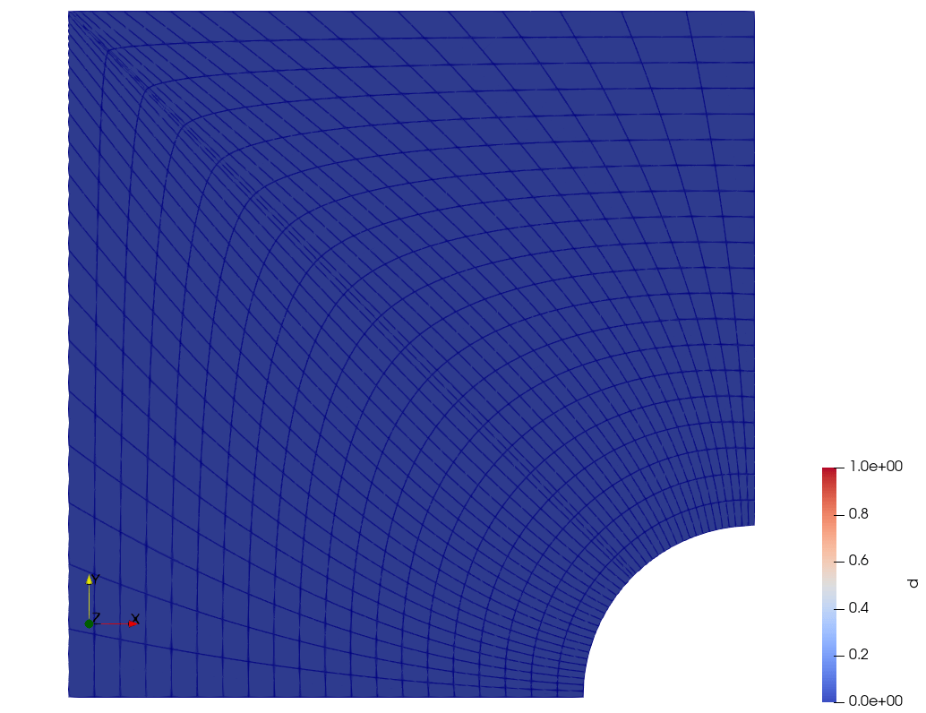
Phase-field fracture with IGA.jl
Just for fun: Phase-field brittle fracture
Model from Bharali et al. (2023)
FerriteAssembly.jl for assembly
Using IGA.jl for mesh and interpolations
R. Bharali, F. Larsson, and R. Jänicke, “A micromorphic phase-field model for brittle and quasi-brittle fracture,” Comput. Mech., 2023

Slide 30
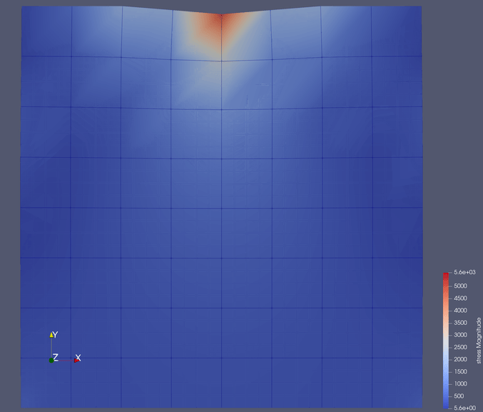
P4est Adaptive mesh refinement
Maximilian Köhler,
Ruhr Universität Bochum

Slide 31
Community and documentation
Documentation and examples: https://ferrite-fem.github.io/Ferrite.jl/
Slack: https://julialang.org/slack/, and join #ferrite-fem
Getting help
Sharing code snippets
Discussion about solving problems, theory, etc.
Github
Issues: Requesting features / reporting bugs
PRs: Making fixes / enhancements
Discussions: Asking questions
FerriteCon2024: September 16th, Gothenburg, Sweden
https://ferrite-fem.github.io/FerriteCon

